Slide 1

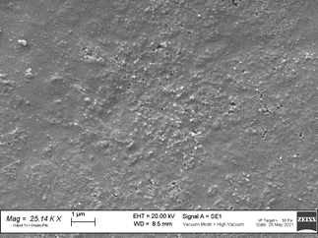
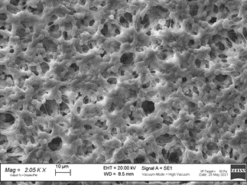
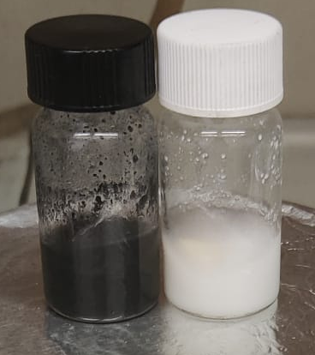
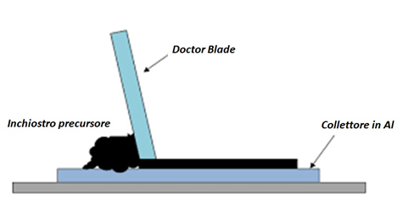
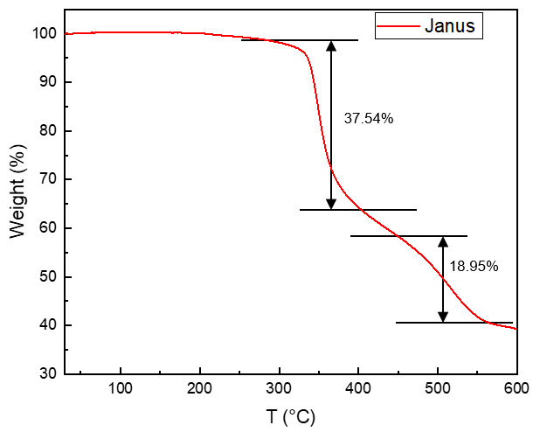
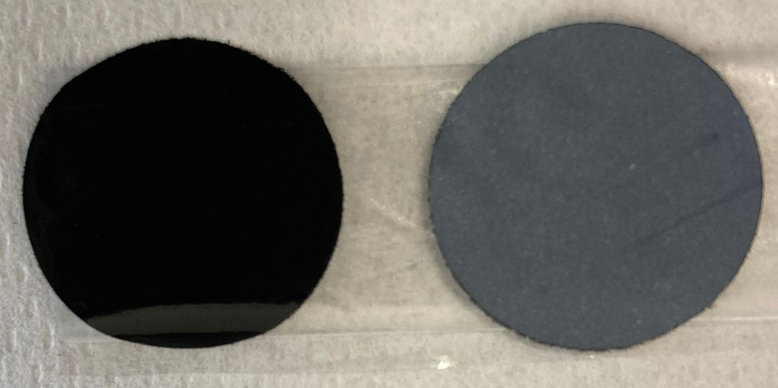
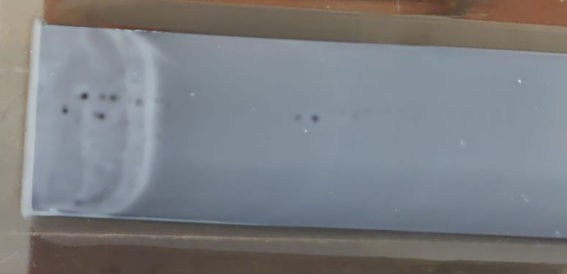
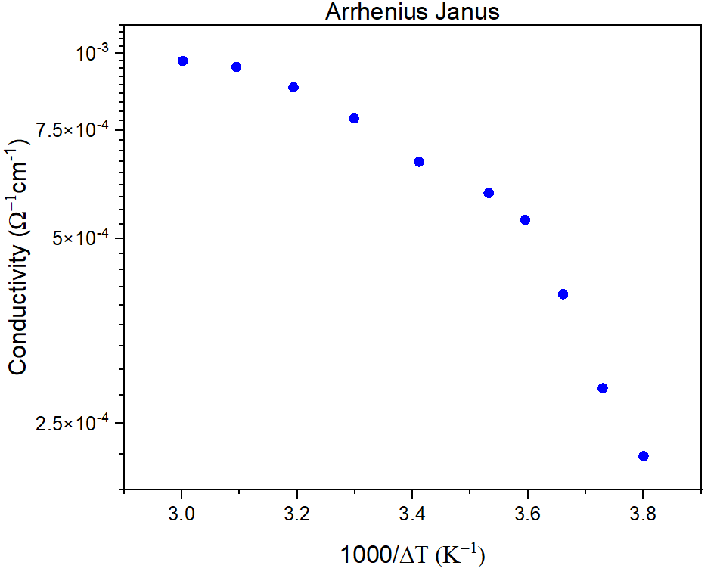
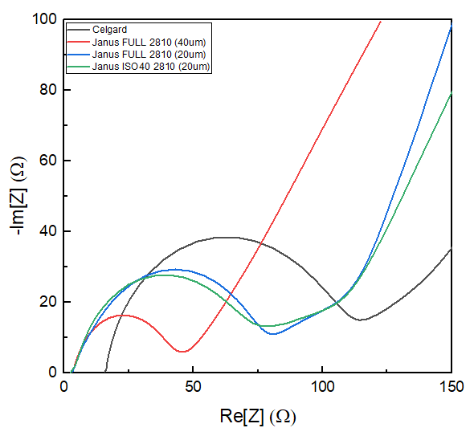
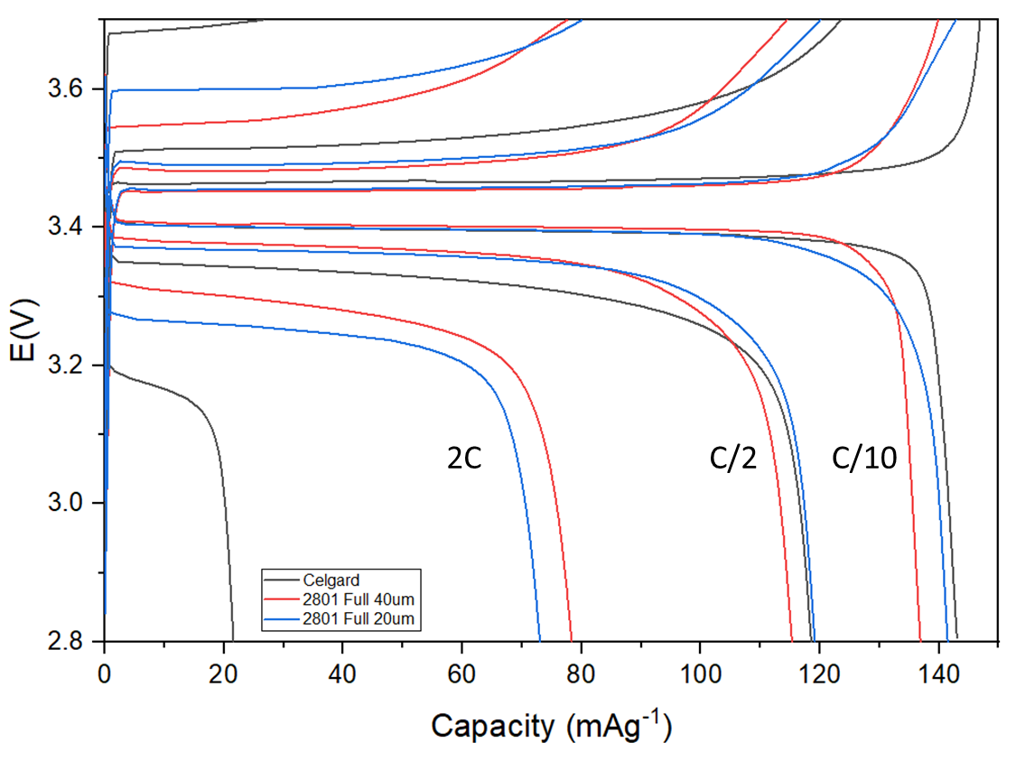
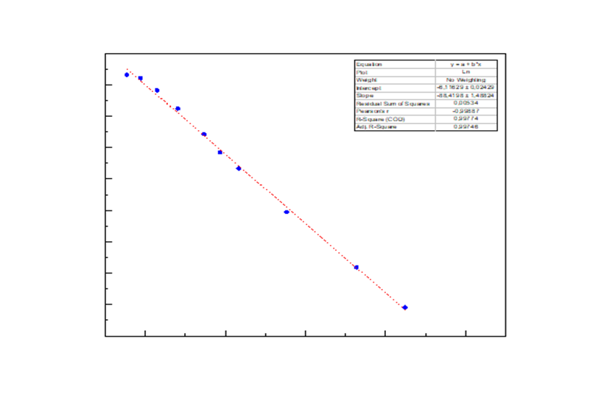
Poly(vinylidenefluoride)-based Janus separators for lithium batteries
ª Riccardo Morina; ª Rebecca Baroni, ^{b}Eliana Quartarone, ª Piercarlo Mustarelli
ª Department of Materials Science, University of Milano Bicocca, and GISEL-INSTM, via Cozzi 55, 20125 Milano
^{b} Department of Chemistry, University of Pavia, and GISEL-INSTM, via Taramelli 16, 27100 Pavia
System
Janus separator: heterogenous polymeric membrane where the two faces are functionalized one to improve the conductivity on the cathode interface (conducting phase) and the other to contain the dendrite growth in the anode (insulating phase)^{[1]}.
Janus separator
SEM Image of conducting phase
cathode
anode
SEM Image of insulating phase
Focus
In this work we report on a nano-composite Janus separator made by an insulating side, in contact with the anode, based on PVDF-HFP and Al₂O₃ and a semiconducting side including multi-walled nanotubes (CNT’s).
Synthesis
Insulating phase:
Kynar Flex PVDF 2801®: Al₂O₃ nanopowder in acetone and polycarbonate.
Conducting phase:
Kynar Flex PVDF 2801®: Al₂O₃ nanopowder: CNTs multi-walled: Super P in acetone and polycarbonate.
The solutions were mixed by stirring at 60°C in sealed vials, after 2 days the vials were open so to give a homogeneous slurry. The slurries were cast using a doctor blade, depositing first the conducting phase then, when it was completely dry, the insulating phase.
Structural characterization
TGA shows the behaviour of our separator in a range of working T and its degradation, our separator show a good stability in the range of temperatures commons for lithium ion e batteries, the degradation start at 353°C, how it was expected by a PVDF-hfp films.
Conducting
Insulating
Doctor Blade casting
Coin Cell
Electrochemical characterization
Spring
Spacer
Li
Separator
LFP
To test the Janus’s electrochemical properties we used a coin cell geometry. For the conductivity studies we prepared a stainless steel/stainless steel cell with 1M LiPF₆ in EC:DMC (LP30 commercial solution). The separator was then tested in a full cell Li/Janus/LiFePO₄ with LP30. We compared a cell mounting a standard Celgard® separator (20 μm) with two cells with Janus separators with different thickness (20 μm and 40 μm). The cells were cycled using a BioLogic bst 300® GCPL at C/10, C/2 and 2C considering as theorical capacity 150 mA/g.
Electrochemical Impedance Spectroscopy showed that the resistance of LP30 is lower in the Janus separators (3.4 Ω for both the 20 μm and the 40 μm) than that of Celgard® (15.6 Ω). the GCPL show a good capacity (140-143 mAg⁻¹) for the all cells at C/10, whereas at 2C the Janus cells showed a capacity higher (73 mAg⁻¹ and 77 mAg⁻¹) than that of Celgard® (22 mAg⁻¹).
References
[1] M. S. Gonzalez, Q. Yan, J. Holoubek, Z. Wu, H. Zhou, N. Patterson, V. Petrova, H. Liu, and P. Liu, Adv. Mater, 2020, 1906836

