Slide 1

Multi-Professional Rehabilitation therapeutic community programme in Lombardy Public Health Psychiatric Care for a person with Intellectual Disability and her Family
Jacopo Santambrogio
Psychiatry 3rd year Resident,
University of Studies Milano-Bicocca
Tiziana Ibatici
Professional Psychiatry
Nurse, C.R.A.
Besana in Brianza (MB)

Slide 2
Andreina Nov.21st 1977
37 years old (1977), overweight (108 kg), light blue and sweet eyes woman
She was born in 1977, twin delivery, 2 months premature, with consequent neurological disorder (epilepsia) medicated with VPA, Ethosuximide and Gardenale
Father (1946): pathological gambler with aggressive personality
Mother (1947): catholic and firm, helps her husband with family business
Andrea (1971), the brother: a good work functioning person with Intellectual Disability

Slide 3
Andreina studied in a special school and centre for ID for youth (Nostra Famiglia in Bosisio Parini) and was diagnosed as “a person with a learning disorder associated with a brain disorder”
Moderate Intellectual Disability, with Verbal QI: 50, performance QI: 60, total QI: 52 (2009)
2007: she was kept in charge by Psychiatric Outpatient Services: psychiatrist + professional educator (at a day center)
Symptoms: agoraphobia and social phobia + conflictual family
Internship at Monza's stables, a sheltered job at “Cooperativa Il Seme” and Day Center
2 relationships were interrupted by herself because of moral issues and relatives disagreement

Slide 4



From 2007 until now: 10 psychiatrists and so many medications!
First psychopharmacological treatment: mood stabilizer (VPA) + SSRI (Paroxetine)
SSRI: Paroxetine, Cipralex, Sertraline, Fluoxetine, Wellbutrin, Cymbalta
Antipsychotics: Zyprexa, Seroquel RP, Clozapine, Largactil, Abilify, Talofen
Anxiolitics: En, Xanax, Rivotril, Gabapentin
Mood Stabilizers: Depakin
Trittico

Slide 5
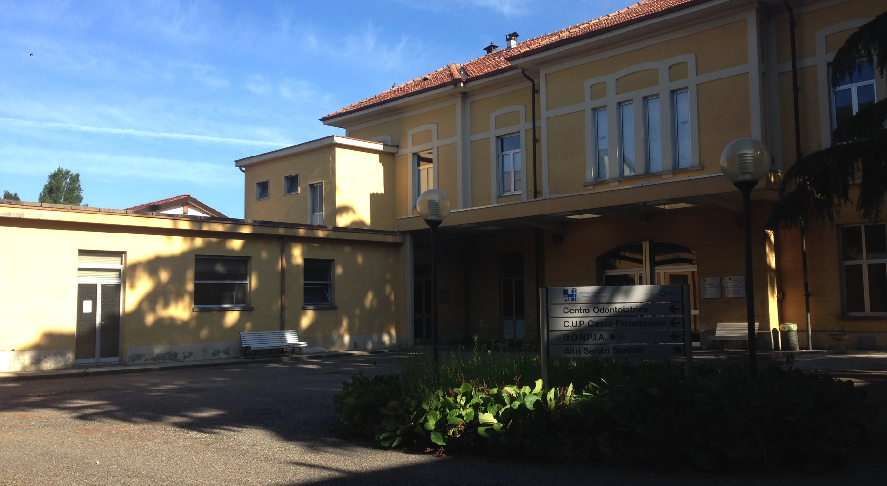

Slide 6
Jacopo
Psychiatry
Resident
Andrea
Brother
Tiziana
Nurse
Father
Andreina
Barbara
Professional Educator
Anna Rita
Nurse
Mother
Giuseppe Grieco
Patient

