Slide 1


The MAastricht Instrument for Sustainable Employability – Italian version (MAISE-IT): a validation study
Eleonora Picco¹, Vittorio Tripeni, Andrea Gragnano, Inge Houkes, Angelique De Rijk, Massimo Miglioretti
¹University of Milano-Bicocca, Department of Psychology
“Labour is not a commodity” Bergamo, 29th November

Slide 2
Sustainable Employability (SE) (Van der Klink et al. 2016)
“Sustainable employability means that, throughout their working lives, workers can achieve tangible opportunities in the form of a set of capabilities. They also enjoy the necessary conditions that allow them to make a valuable contribution through their work, now and in the future, while safeguarding their health and welfare. This requires, on the one hand, a work context that facilitates this for them and on the other, the attitude and motivation to exploit these opportunities” (p.4)

Slide 3
Sustainable Employability (SE): 4 core components (Hazelzet et al. 2019)
Health
Well-being, Quality of working life, Vitality, Lifestyle, Mental and Physical Health
Productivity
Work ability, Productivity, Work engagement
Valuable work
Perceived positive attitude, Job motivation, Competences, Skills and knowledge
Long-term perspective
Long-term effects for all work ages

Slide 4
Why do we aim to promote Sustainable Employability?
Ageing societies require health and well-being’ employees preservation and work performance maximization (De Jonge and Peeters, 2019)
Digitalized economy and network society require advanced skills (Cedefop, 2016)
Enterprises have to find innovative digital business models, giving top priority to quality and safety of working life (Müller, Gust, Feller and Shiffman, 2015)

Slide 5
The MAastricht Instrument for Sustainable Employability (MAISE): 5 areas (Houkes et al. submitted)
Meaning of SE according to employee (2 scales, 10 items)
Employee SE (2 scales, 8 items)
Factors affecting the employees’ SE (3 scales, 13 items)
Responsibility for overall employee SE (1 item, items)
Responsibility for factors affecting the employees’ SE (5 scales, 18 items)

Slide 6
The MAastricht Instrument for Sustainable Employability (MAISE): 5 areas – example items (Houkes et al. submitted)
Meaning of SE
“I can do my job without too much stress”
“Being able to do my work until I retire”
Employee SE
“I have the required knowledge to perform my job”
“My job is stressful”
Factors affecting the employees’ SE
“Atmosphere improvement within my department/team”
“Introduce more flexible working hours”
Responsibility for overall employee SE
“With whom does the responsibility for sustainable employability
lie according to you?”
Responsibility for factors affecting the employees’ SE
“Reach a healthier body weight”
“Improvement of working conditions”

Slide 7
Method: Italian participants
Variable | Total sample | PAA sample | C sample
N | 455 | 328 | 127
Age (mean) | 46.7 | 48.9 | 40.2
Gender (%)
- men | 40.5 | 43.5 | 31.9
- women | 59.5 | 56.5 | 68.1
Education (%)
- primary school | 0.2 | 0.3 | 0
- middle school | 0.2 | 0.3 | 0
- lower professional education | 5.0 | 4.6 | 6.3
- secondary school | 25.4 | 26.8 | 21.4
- post-secondary education | 3.9 | 4.0 | 3.6
- bachelor's degree | 7.6 | 6.2 | 11.6
- master's degree | 42.3 | 42.8 | 41.1
- post-degree master or PhD | 14.9 | 15.1 | 14.3
- other | 0.5 | 0 | 1.8
Education (level)
(1) < post-secondary education | 30.9 | 32.0 | 27.7
(2) post-secondary education/university | 68.7 | 68.0 | 70.6
Occupational activity (%)
- white-collars | - | - | 57
- blue-collars | - | - | 9
- pink-collars | - | - | 13
- n.d. | - | - | 21

Slide 8
Risorse umane diapositiva 11
Results: construct validity
MAISE-IT area |  | p | Chi-2 (df) | CFI | TLI | SRMR | RMSEA (CI)
1 | Meaning of SE (2 factors) | <.001 | 120 (33) | .932 | .907 | .041 | .076 (.062–.091)
2 | Level of SE (2 factors) | <.001 | 61.3 (18) | .946 | .916 | .041 | .072 (.053–.093)
3 | Factors affecting SE (3 factors) | <.001 | 242 (61) | .925 | .904 | .049 | .080 (.070–.091)
5 | Responsibility for factors affecting SE (5 factors) | <.001 | 416 (122) | .932 | .915 | .006 | .073 (.065–.080)

Slide 9
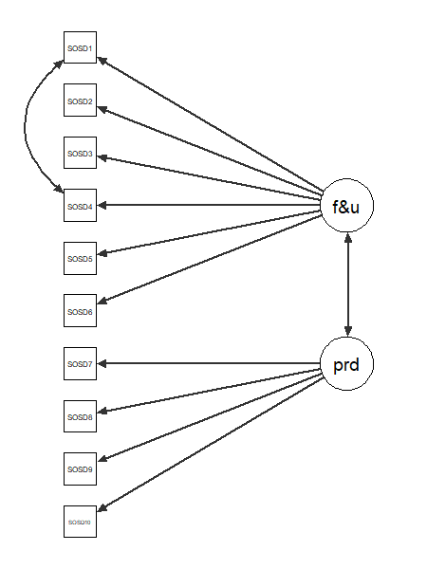
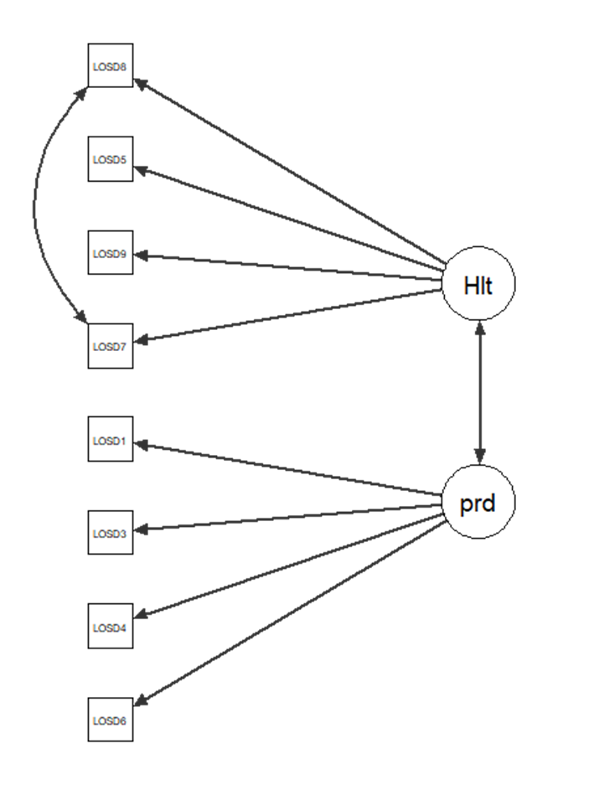
Risorse umane diapositiva 11
Results: construct validity – scales
Meaning of SE
Fit & Useful Productive
Employee SE
Performance Health issues

Slide 10
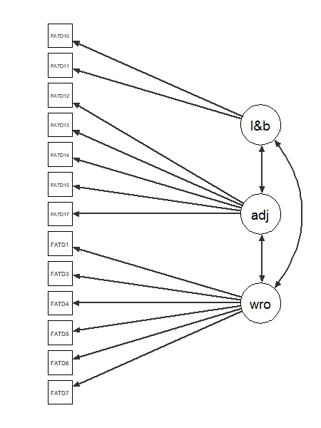
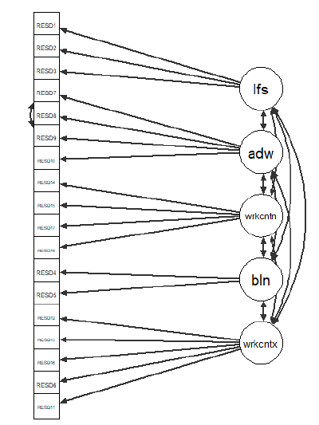
Risorse umane diapositiva 11
Results: construct validity – scales
Factors affecting the employees’ SE
Work organisation
Lifestyle & Balance
Adapted job
Responsibility for factors affecting the employees’ SE
Lifestyle Balance Adapted job
Work content Work context

Slide 11
Work-Health Balance (Miglioretti, Gragnano & Simbula 2016)
“A state in which the worker feels able to effectively balance health and work needs, considering management’s attention to employee health and the perception of compatibility between one’s personal health situation and job characteristics” (p.376)

Slide 12
The Work-Health Balance questionnaire (WHBq) (Gragnano et al. 2017)
Work-health incompatibility (6 items)
“Your job lets you take care of your health”
Health climate (5 items)
“In my organization, health prevention involves all levels of the organization”
External support (6 items)
“Your supervisor listens when you talk about your health”

Slide 13

Results: concurrent validity and reliabilities
Variableᵃ | 1a | 1b | 2a | 2b | 3a | 3b | 3c | 4 | 5a | 5b | 5c | 5d | 5e | 6 | 7 | 8 | 9
MAISE-IT scales
1a | -
1b | .58** | -
2a | .16** | .22** | -
2b | .05 | .12* | .17** | -
3a | .34** | .25** | -.01 | .02 | -
3b | .09* | .22** | -.00 | .26** | .21** | -
3c | .28** | .22** | .03 | .24** | .34** | .50** | -
4 | .07 | .06 | .07 | .01 | -.03 | -.00 | -.09 | -
5a | .09 | -.03 | .03 | -.11* | .03 | -.15** | .13** | .03 | -
5b | -.02 | .12* | .04 | .02 | -.03 | .04 | -.09 | .13** | .05 | -
5c | -.06 | .11* | -.01 | .11* | .04 | .21** | .12* | .10* | -.28** | .39** | -
5d | -.03 | .09 | .00 | .03 | -.01 | .17** | .09* | .14** | -.18** | .32** | .68** | -
5e | -.06 | .12** | .04 | .05 | -.01 | .19** | .06 | .16** | -.21** | .50** | .76** | .74** | -
WHB-q scales and index
6 | .01 | .02 | -.16** | .40** | .04 | .22** | .30* | -.09* | -.07 | -.09 | .02 | .02 | -.05 | -
7 | .04 | .07 | .17** | -.09* | -.02 | -.01 | -.08 | .17** | -.01 | .20** | .19** | .25** | .27** | -.29** | -
8 | .02 | -.00 | .12** | -.14** | -.03 | -.10* | -.25** | .11* | .02 | .10* | .06 | .11* | .07 | -.40** | .47** | -
9 | .02 | .01 | .20** | -.33** | -.04 | -.18** | -.30** | .14** | .06 | .15** | .07 | .10* | .15** | -.86** | .66** | .73** | -
Cronbach’s alpha | .78 | .70 | .75 | .37 | .79 | .91 | .82 | - | .65 | .47 | .86 | .85 | .84 | .87 | .77 | .90 | -
ᵃVariable: 1a = Fit & Useful; 1b = Productive; 2a = Performance; 2b = Health issues; 3a = Work organisation; 3b = Lifestyle & Balance; 3c = Adapted job; 4 = Overall responsibility for SE; 5a = Responsibility for lifestyle; 5b = Responsibility for balance; 5c = Responsibility for adapted job; 5d = Responsibility for work content, 5e = Responsibility for work context; 6 = Work–health incompatibility; 7 = Health climate; 8 = External support; 9 = WHB index.

Slide 14
Results: means, standard deviations and percentiles
Scale (range 1-5) | # items |  | M | SD | 25th percentile | 75th percentile
1. Meaning of SE
1a. Fit & Useful | 6 | 4.24 |  | .53 | 4.00 | 4.67
1b. Productive | 4 | 3.71 |  | .72 | 3.25 | 4.25
2. Level of SE
2a. Performance | 4 | 3.99 |  | .58 | 3.75 | 4.50
2b. Health issues | 4 | 2.73 |  | .58 | 2.25 | 3.00
3. Factors affecting SE
3a. Work organisation | 6 | 3.86 |  | .66 | 3.50 | 4.33
3b. Lifestyle & balance | 2 | 2.89 |  | 1.19 | 2.00 | 4.00
3c. Adapted job | 5 | 3.53 |  | .86 | 3.00 | 4.20
4. Responsibility for employee SE (n=450)
Who is responsible for employee Sustainable Employability? | 1 | 2.65 |  | .54 | 2.00 | 3.00
5. Responsibility for factors affecting SE
5a. Lifestyle | 3 | 3.86 |  | .75 | 3.33 | 4.33
5b. Balance | 2 | 3.28 |  | .74 | 3.00 | 3.50
5c. Adapted job | 4 | 2.12 |  | .87 | 1.50 | 2.50
5d. Work content | 4 | 2.57 |  | .77 | 2.00 | 3.00
5e. Work context | 5 | 2.49 |  | .75 | 2.00 | 2.80
Note: A higher score/percentile reflects a more positive score on the particular variable, except for the “health issues” subscale: here a higher score reflects more health problems. A higher score/percentile on scale 3 means that this particular factor contributes a lot to SE. A higher score/percentile on scales 4 and 5 means that responsibility lies mainly with the employee.

Slide 15

Results: subgroup analyses
* p < .10; ** p < .05.

Slide 16
Discussion
This study showed the MAISE-IT to be valid in the Italian context
More validation and follow-up studies are needed in larger samples from various working sectors, PMIs and among vulnerable groups such as employees with health issues, older and younger employees, self-employed employees and low-educated employees
Sustainable Employability concept was moderately associated with WHB concept, without overlapping it. This finding underlines the importance of health management at work
Only one working sector and a small convenience sample
Only one proxy
Cross-sectional data
Notes:
WHB

Slide 17
Implications for practice and further research
The MAISE-IT should be used to assess employees’ needs in order to develop group (or subgoup) interventions that fit the employee perspective, and to evaluate its effectiveness
The MAISE-IT could be implemented in digital platforms in order to assess and monitor employee SE, and to evaluate long-term effects of technology-based interventions
If SE is considered a shared responsibility, government and social partners are called to play a fundamental role in terms of SE policy development

Slide 18
Thank you!
Eleonora Picco, PhD Candidate
Department of Psychology
University of Milano-Bicocca
e.picco1@campus.unimib.it

