Slide 1




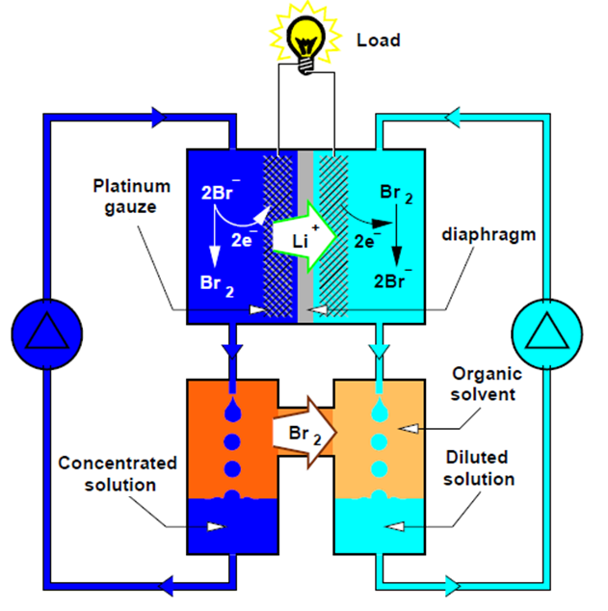
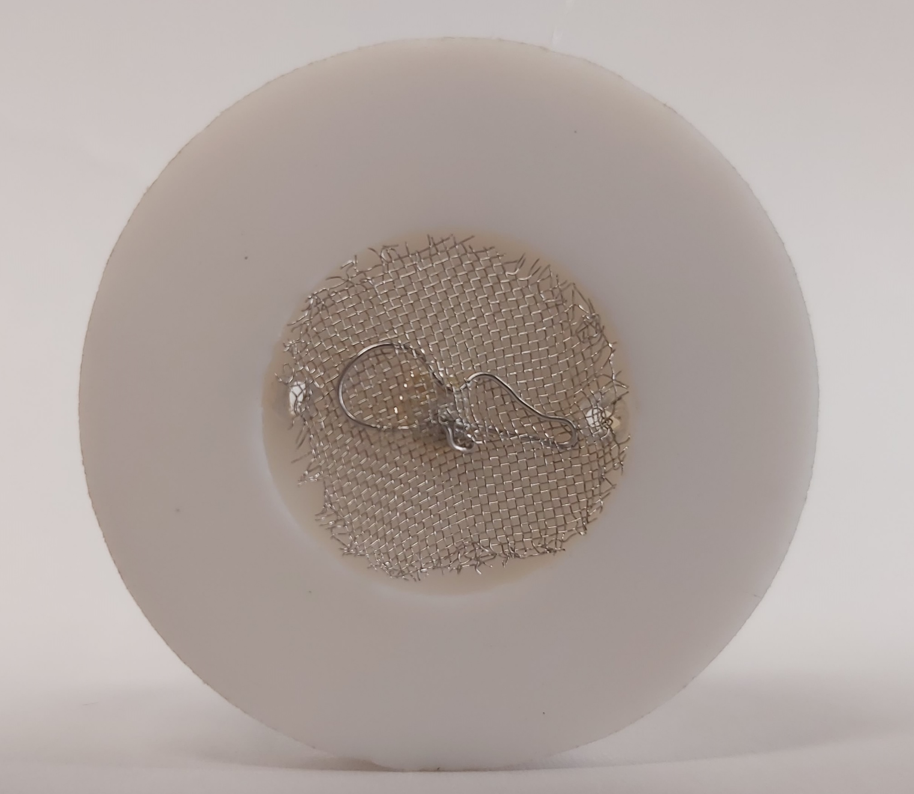
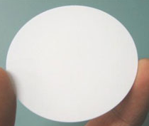
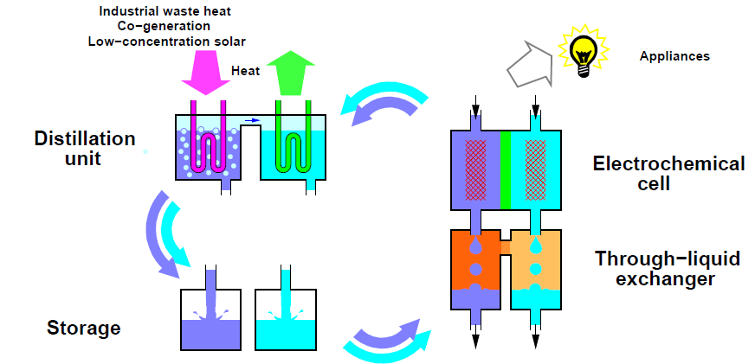
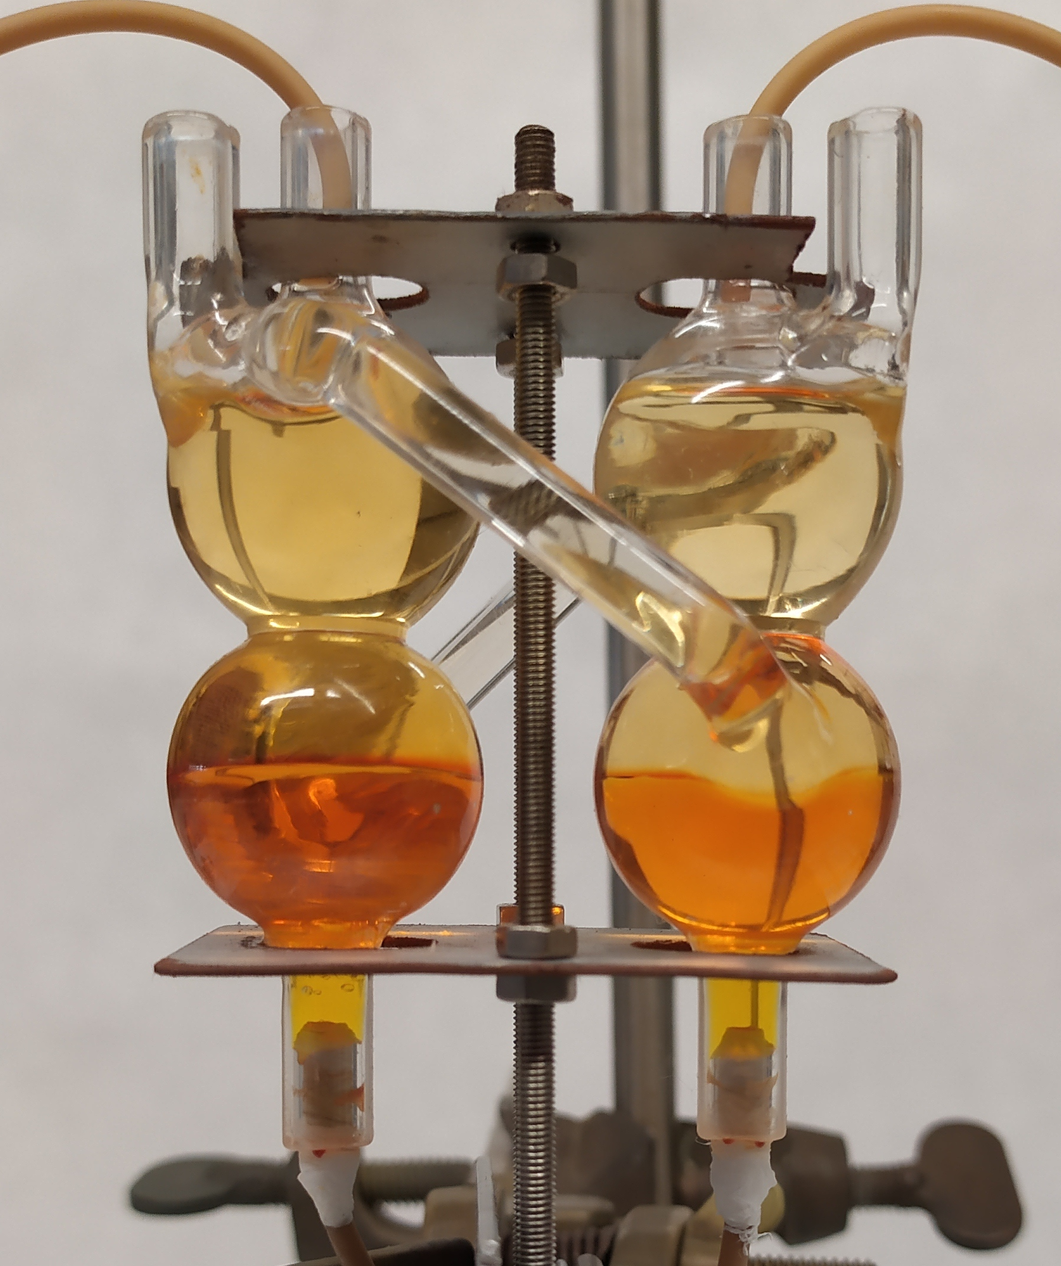
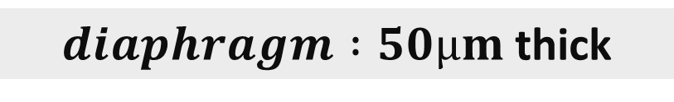
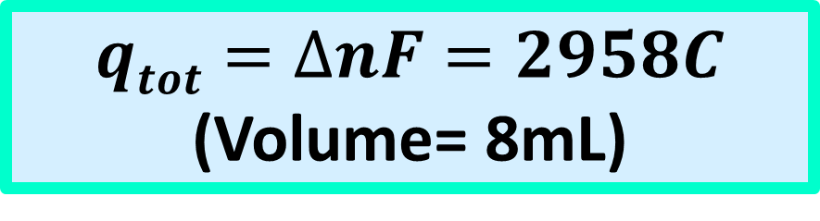
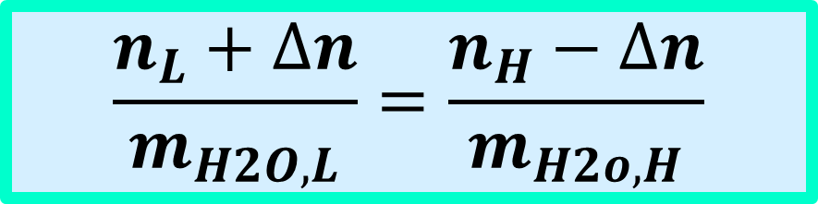

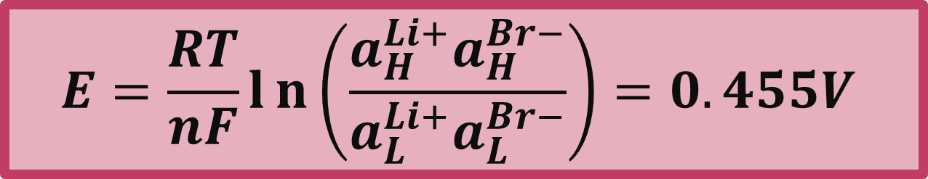
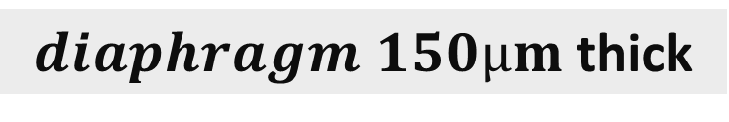
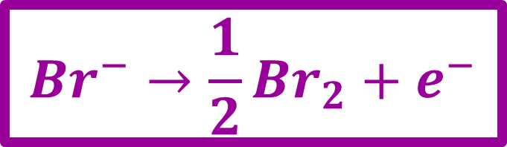
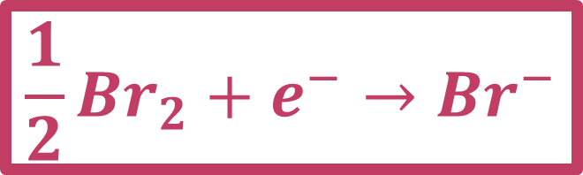
Thermally Regenerable Redox-Flow Batteries
I. Facchinettiª, E. Cobaniª, D.Brogioli^{b}, F. La Mantia^{b}, R. Ruffoª
a) Department of Materials Science – University of Milano Bicocca, Via Cozzi 55, 20125 Milano, Italy
b) Department of Production Engineering – University of Bremen, Bibliothekstraße 1, 28359, Bremen, Germany
i.facchinetti3@campus.unimib.it
TRB is an electrochemical cell which produces electrical current by utilizing solutions, with the same composition, but different concentrations. The two solutions can be regenerated by distillation exploiting low temperature heat (<100°C). The produced energy is extracted at the expenses of the mixing free energy of the two solutions.
H
L
TRB stores energy in form of solutions and it will enable to convert heat from:
geothermal sources, industrial waste heat, solar heat collected by low-concentration optics, household-cogeneration in a more efficient way then the traditional thermoelectrical converters (η≈1%)^{1,2}
H
$${Br}^{−}→{\frac{1}{2}Br}_{2}+e^{−}$$
L
$${{\frac{1}{2}Br}_{2}+e}^{−}→{Br}^{−}$$
Distillation energy efficency vs temperature
of the heat sources at the pressure where
water boils at 30°C.
Thermodynamic Analysis
Dependance of cell voltage by molar fraction of diluted solution at fix molar fraction of concentrated solution (26%)
$$η_{distillation}∗η_{TRB} \text{≈ 10\%}$$
$$E=\frac{RT}{nF}ln\left(\frac{a_{H}^{Li+}a_{H}^{Br−}}{a_{L}^{Li+}a_{L}^{Br−}}\right)=0.455V$$
$$\frac{n_{L}+∆n}{m_{H2O,L}}=\frac{n_{H}−∆n}{m_{H2o,H}}$$
$$qtot=∆nF=2958C$$
(Volume= 8mL)
Working Conditions:
X_{H} = 26%
X_{L} = 2.5%
T = 45°C
Energy (Δ_{mix}G)
25.3Wh/L
$diaphragm :50µm$ thick
Experimental Data
Discharge at 15Ω
Impedence analysis
Constant current (5mA) discharge
Constant Load discharge experiments done for two different membrane thicknes.
Data shows that, for the same discharged time, in the case of 50µm diaphragm we extracted 3 times the energy extracted from 150µm diaphragm experiment. This difference is attributed to the lower internal resistance of 50µm diaphragm.
During these experiments it was observed that the internal resistance changes in time mainly due to the experimental setup.
Discharge at 15Ω
Discharge at 30 Ω
$diaphragm 150µm$ thick
FUTURE STEPS
Constant load (50Ω) discharge
SUMMARY
Optimization of the experimental setup
Maximize the energy outputted by implementing several electrodes and diaphragms in parallel
Study new redox-systems
Extracted energy (150µm diaphragm) ≈ 6%
Extracted energy (50µm diaphragm) ≈ 20%
[1] T.C. Hung, T. Y. Shai, and S. K. Wang. A, Energy, 22(7):661–667, 1997.
[2] G. J. Snyder and E. S Toberer. Nat. Mater., 7(2):105–114, 2008.

