Slide 1

Psychological dynamics in different classes of individuals
Giulio Costantini
giulio.costantini@unimib.it
CCS2018 27/09/2018

Slide 2
What are psychologists trying to model?
Personality: An individual’s characteristic patterns of thought, emotion, and behavior, together with the psychological mechanisms—hidden or not—behind those patterns.
e.g., extraversion: being sociable, lively, self-assured, liking parties, feeling energetic around people...
Psychopathology. Dysfunctional characteristics of the individual.
e.g., depression: depressed mood, fatigue, insomnia, worrying.

Slide 3
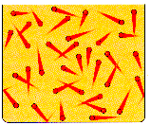
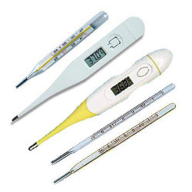
Psychological traits as latent variables
Correlations among symptoms thoughts, emotions, and behaviors are explained with latent variables, unobservable common causes
(e.g., McCrae & Sutin, 2018).
e.g. Anna reports symptoms such as fatigue, insomnia, worrying. We infer that she is depressed.
e.g. John has many friends, loves people and goes to parties because he is extraverted.

Slide 4
Psychological traits as complex systems
Personality and psychopathology may emerge from causal interactions among cognitions, emotions, behaviors.
e.g. Insomnia increases fatigue, which in turn worsens concentration problems and so on. This leads to depressed mood.
e.g., Liking people leads to going to parties, going to parties leads to making more friends. This leads to extraversion.
(Cramer et al., 2012; Borsboom & Cramer, 2013; Costantini et al., 2015)

Slide 5
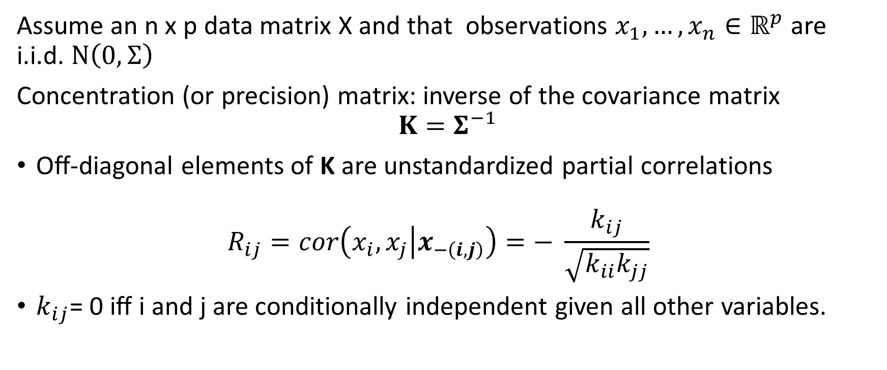
Gaussian Graphical Model (1)
Assume an n x p data matrix X and that observations $x_{1},…,x_{n}∈ℝ^{p}$ are i.i.d. $N\left(0, Σ\right)$
Concentration (or precision) matrix: inverse of the covariance matrix
$${K=Σ}^{−1}$$
Off-diagonal elements of K are unstandardized partial correlations
$R_{ij}=cor\left(x_{i},x_{j} | x_{−\left(i,j\right)}\right)=− \frac{k_{ij}}{\sqrt{k_{ii}k_{jj}}}$
$k_{ij}$= 0 iff i and j are conditionally independent given all other variables.
(Epskamp et al., 2018; Lauritzen, 1996)

Slide 6
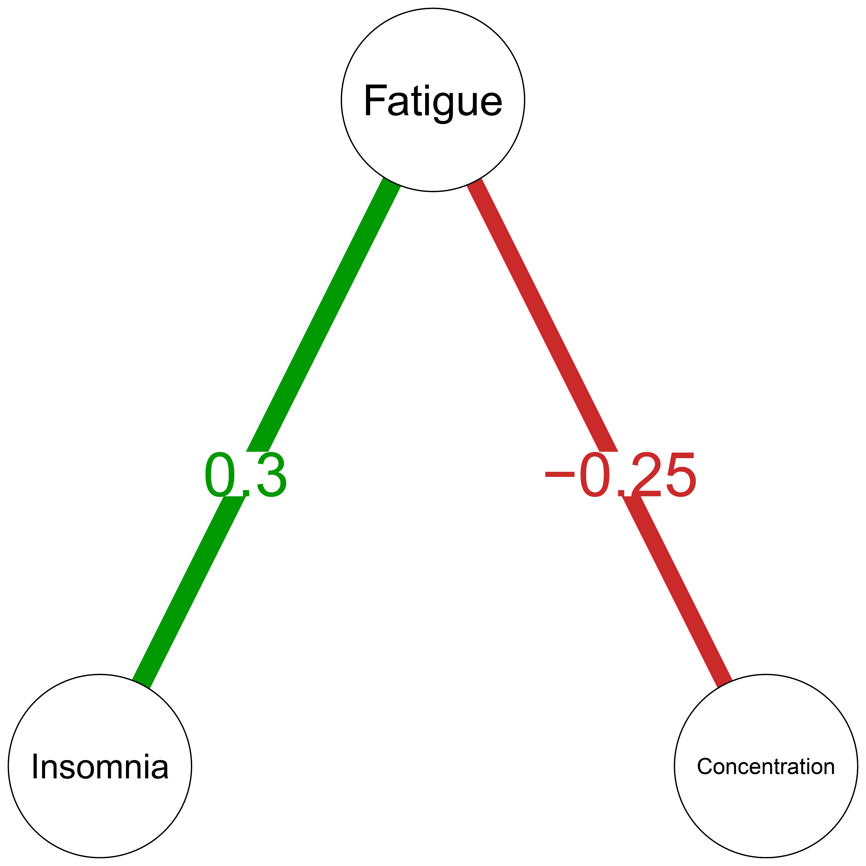
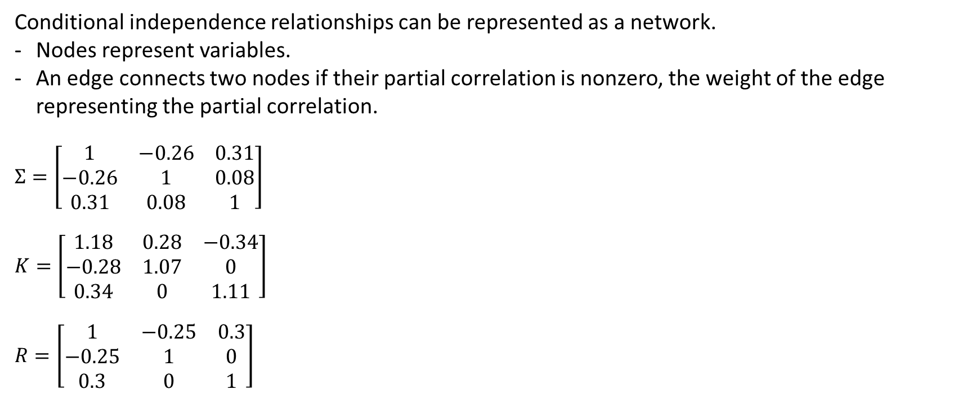
Gaussian Graphical Model (2)
Conditional independence relationships can be represented as a network.
Nodes represent variables.
An edge connects two nodes if their partial correlation is nonzero, the weight of the edge representing the partial correlation.
$$Σ=\left[\begin{matrix}1 & −0.26 & 0.31 \\ −0.26 & 1 & 0.08 \\ 0.31 & 0.08 & 1\end{matrix}\right]$$
$$K=\left[\begin{matrix}1.18 & 0.28 & −0.34 \\ −0.28 & 1.07 & 0 \\ 0.34 & 0 & 1.11\end{matrix}\right]$$
$$R=\left[\begin{matrix}1 & −0.25 & 0.3 \\ −0.25 & 1 & 0 \\ 0.3 & 0 & 1\end{matrix}\right]$$
(example by Epskamp et al., 2018)

Slide 7
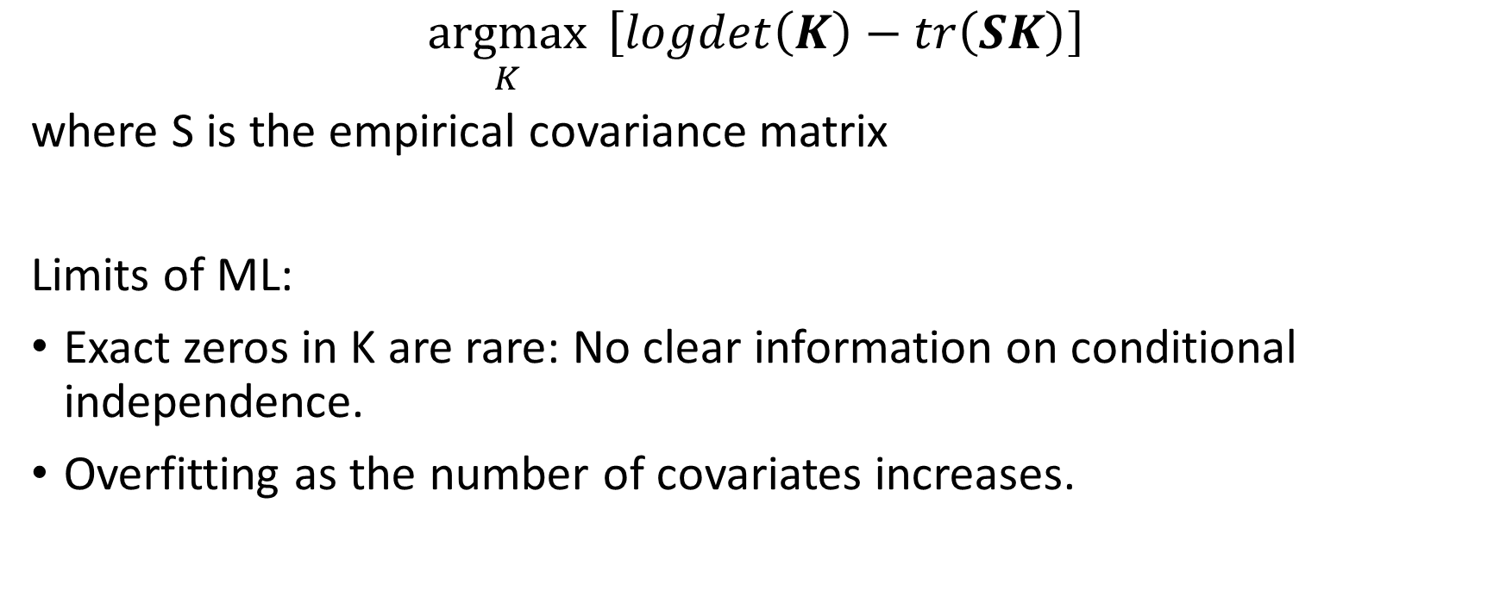
Estimating K: Maximum likelihood
$$\underset{K}{argmax}{ \left[logdet\left(K\right)−tr\left(SK\right)\right] }$$
where S is the empirical covariance matrix
Limits of ML:
Exact zeros in K are rare: No clear information on conditional independence.
Overfitting as the number of covariates increases.

Slide 8
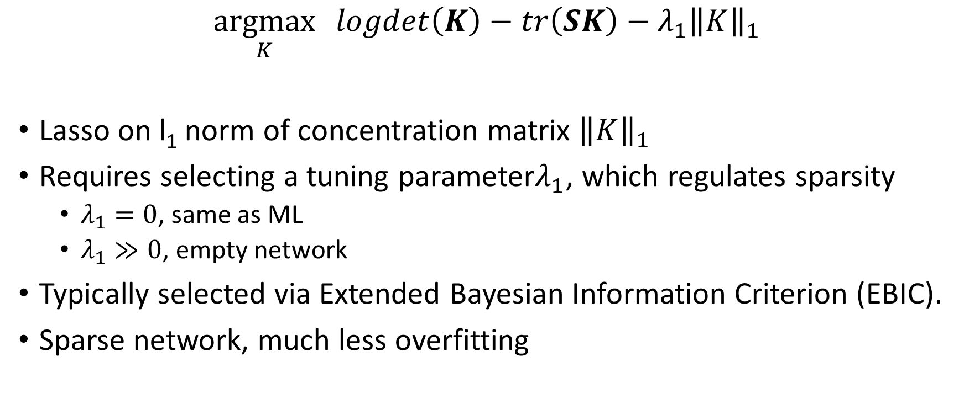
Estimating K: Graphical Lasso (GL)
$$\underset{K}{argmax}{logdet\left(K\right)−tr\left(SK\right)−λ_{1}{\left\|K\right\|}_{1}}$$
Lasso on l₁ norm of concentration matrix ${\left\|K\right\|}_{1}$
Requires selecting a tuning parameter$λ_{1}$, which regulates sparsity
  $λ_{1}=0$, same as ML
  $λ_{1}≫0$, empty network
Typically selected via Extended Bayesian Information Criterion (EBIC).
Sparse network, much less overfitting
(Friedman, Hastie, & Tibshirani, 2008; Chen & Chen, 2008; Foygel & Drton, 2010; Epskamp, 2016)

Slide 9
Which network?
DOMINANCE
ACTIVATION
We will consider two main uses of GGM
Between-subject network. GGM estimated on each individual’s typical levels of thoughts, feelings, behaviors. Encodes dynamics involving variability between subjects.
e.g., “those who are more dominant than other individuals feel also generally more activated”
Within-subject contemporaneous network. GGM estimated on each’s deviation from her mean level. Encodes dynamics involving variability across occasions, excluding variability due to stable individual differences.
e.g., “when someone is more dominant than her average level, she feels also more activated”

Slide 10
Networks describing whom?
Data are often collected on multiple groups of individuals, whose relationships might or might not be different.
e.g., patients vs. controls, individuals with different diagnosis, males and females.
How can we estimate networks in this case?
Single GGM. If the true networks are identical this is the best option.
  It exploits similarities using a larger pooled sample size.
  The price is that all differences are masked.
Separate GGM. Best option if the two networks are totally different.
  if the networks are similar, it does not exploit similarities to improve estimates.
Fused Graphical Lasso (FGL): introduces a regularization on differences among groups. Implemented in R packages JGL and EstimateGroupNetwork
(Danaher, Wang, & Witten, 2014; Costantini et al., 2017)

Slide 11
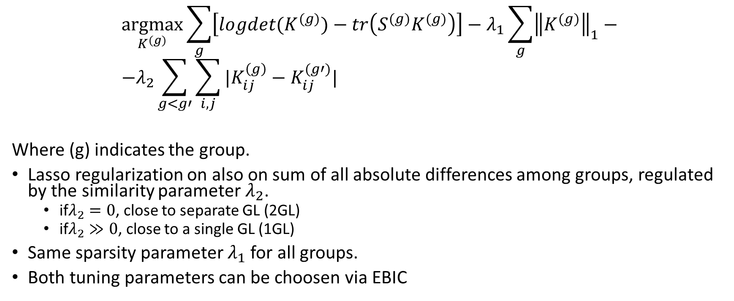
Estimating K for multiple groups: Fused Graphical Lasso (FGL)
$$\underset{K^{(g)}}{argmax}\sum_{g}{\left[logdet(K^{(g)})−tr\left(S^{(g)}K^{(g)}\right)\right]}−λ_{1}\sum_{g}{{\left\|K^{(g)}\right\|}_{1}−} \\ −λ_{2}\sum_{g<g′}{\sum_{i,j}{|K_{ij}^{\left(g\right)}−K_{ij}^{(g′)}|}}$$
Where (g) indicates the group.
Lasso regularization on also on sum of all absolute differences among groups, regulated by the similarity parameter $λ_{2}$.
  if$λ_{2}=0$, close to separate GL (2GL)
  if$λ_{2}≫0$, close to a single GL (1GL)
Same sparsity parameter $λ_{1}$ for all groups.
Both tuning parameters can be choosen via EBIC
(Danaher, Wang, & Witten, 2014, Costantini et al., 2017)

Slide 12
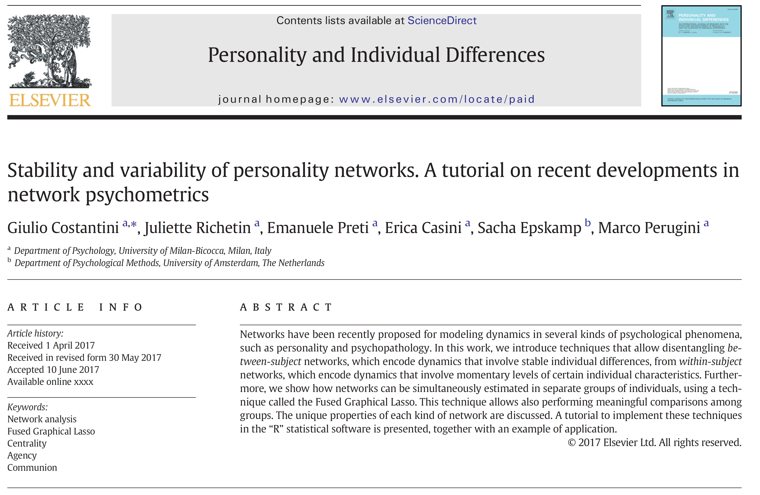

Slide 13
Experience Sampling Method (EMA) dataset
N = 129 participants (51 men and 78 women) reported 2364 social interactions and rated behavior and affect of themselves and of their interactions’ partner.
- Behavior: dominance (domi.S, domi.O), warmth (warm.S, warm.O)
- Emotion: happiness (happ.S, happ.O), activation (acti.S, acti.O)
Data are available at https://doi.org/10.1016/j.paid.2017.06.011

Slide 14
Between Subject dynamics
Edges represent variability between subjects.
The edge between domi.S and domi.O indicates that, all else being equal, individuals who are generally more dominant tend to interact with other dominant individuals.

Slide 15
Between-subject networks - FGL
MEN
WOMEN
Notes:
Man who are generally more active also consider others generally happier
Man who are generaly more dominant, consider others warmer
Women who generally attribute more dominance to others, also attribute others more warmth

Slide 16
Within-subject contemporaneous network
Edges represent variability across occasions.
Many more observations = more power to detect edges -> typically denser networks
The lack of an edge between domi.S and domi.O indicates that one’s dominance in a situation is independent of one’s interaction partners’ dominance in that situation, given other variables in the network.
X

Slide 17
Within-subject networks - FGL
MEN
WOMEN

Slide 18
Fused Graphical Lasso:
Brief illustration of performance in recovering true networks
(Costantini & Epskamp, in prep)

Slide 19
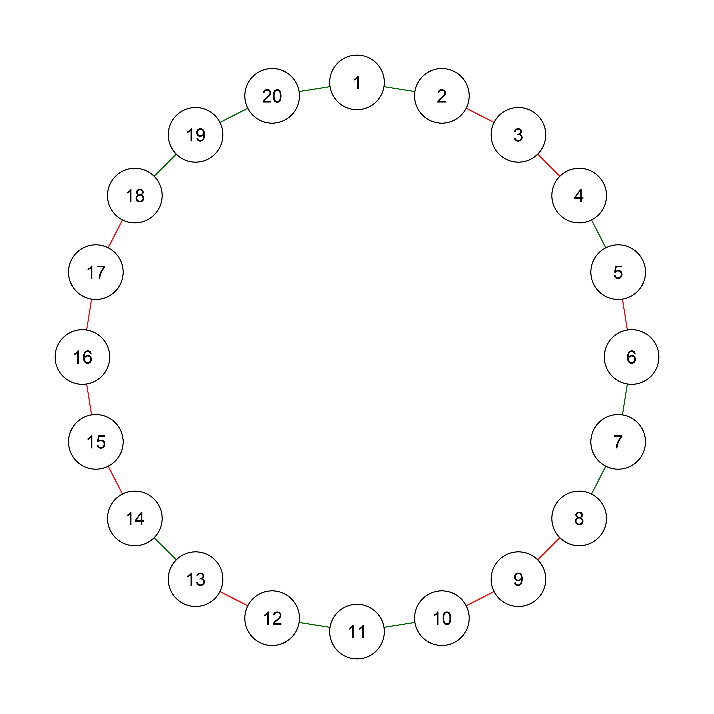
Simulation setup
Generate two identical starting chain graphs:
  20 nodes
  20 edges, 50% negative, Absolute weight = .30
Simulate data for two samples of N = 200
Methods
  1GL: A single GL on all pooled data.
  2GL: Two GL, one on each sample.
  FGL: Fused Graphical Lasso .
Criteria
  Sensitivity (TP/TP + FN).
  Specificity (TN/TN + FP).
  Correlation between true and recovered edges.
1000 replicates by condition

Slide 20
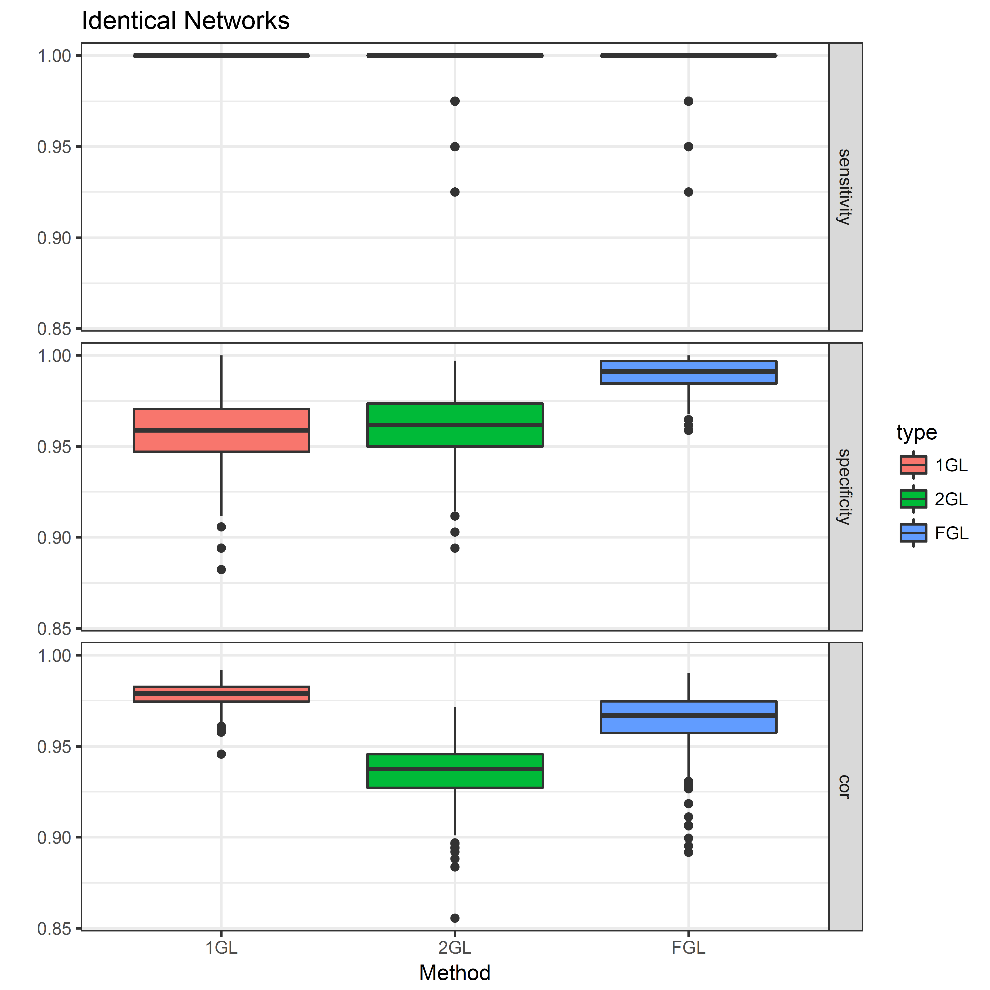
Identical networks

Slide 21
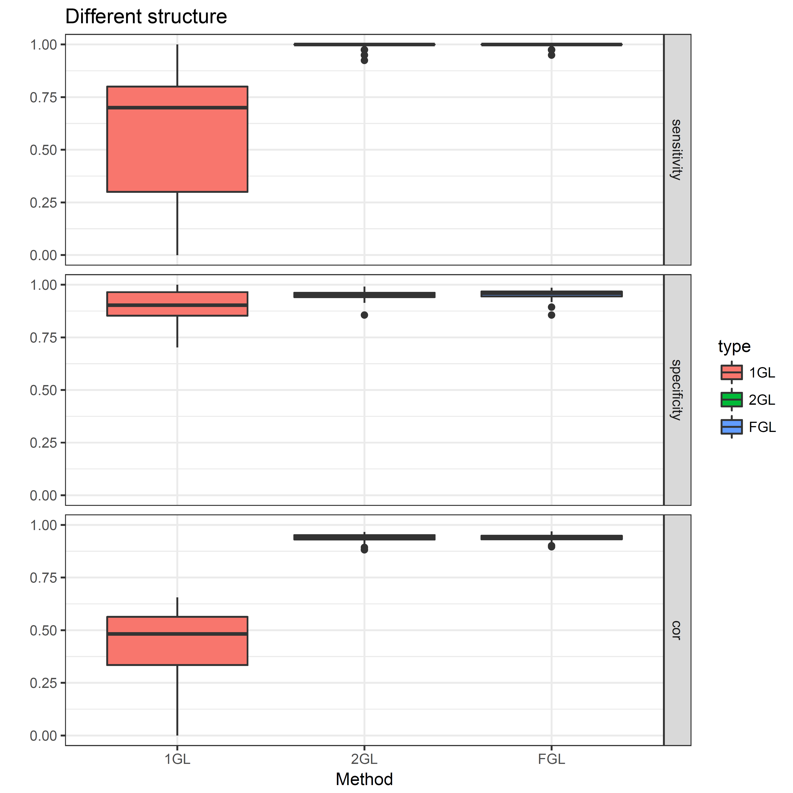
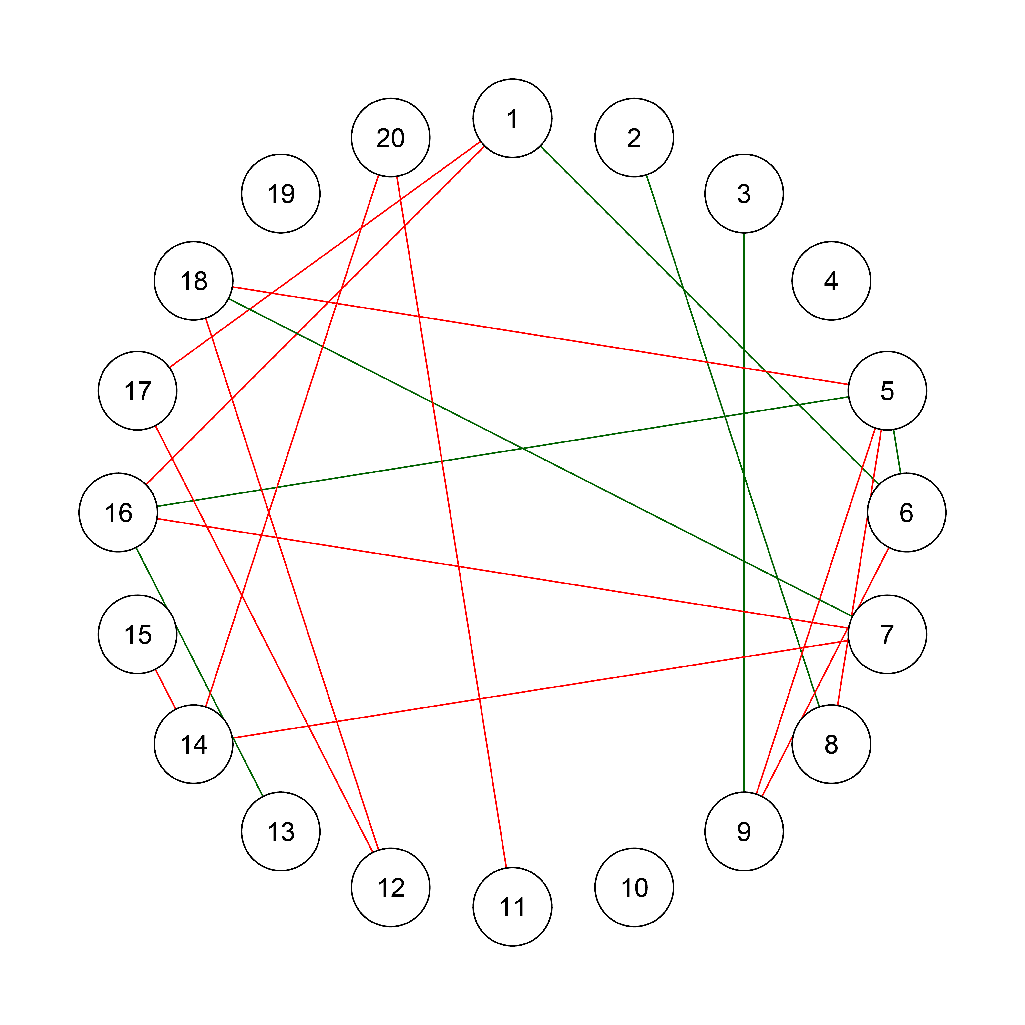
Different structure

Slide 22
Summary of main results
We presented only a few results from a much larger simulation study.
If the true networks are different, FGL (+EBIC) is close to estimating two independent GGMs.
If the two networks are similar, FGL can exploit similarities to improve estimates, being closer to estimating a single GGM.
One typically does not know in advance whether networks are similar or different. FGL provides sufficient flexibility to fit both cases.

Slide 23
Examples
Ways in which FGL can be useful

Slide 24
Example 1 – Post-traumatic stress disorder
PTSD is a condition that develops after experiencing traumatic events (e.g., violence, war, car accitdent...). Symptoms include: Intruding thoughts, nightmares, flashbacks, reactivity, avoidance of thoughts and situations related to trauma, amnesia, lack of interest, sleep problems, irritability...
N = 2782 traumatized patients, collected in four different clinics, reported 16 PTSD symptoms.
  1-2. Dutch Clinics, mixed patients (refugees, soldiers, violence...)
  3. Traumatized Danish Soldiers
  4. Danish Refugees
FGL for comparing BS symptom dynamics in different clinics.
(Fried et al., 2018)

Slide 25
Four groups of PTSD patients
(BS networks)
For Refugees, the connections between (1) intruding thoughts and (4) reactivity and between (15) hypervigilance and (16) exaggeraged startle response were weaker than in the other groups.
Despite a few differences, the four networks resulted remarkably similar, given differences in the nationality and traumas experienced by the four samples
(Fried et al., 2018)

Slide 26
Example 2 - Narcissism
FGL to investigate the dynamics of Narcissism in extreme groups defined by healthy vs. pathological personality structure.
Narcissism is a complex pathological construct that includes both self-enhancing and exploitative attitudes (i.e., narcissistic grandiosity) and negative affectivity and psychological distress (i.e., narcissistic vulnerability).
Pathological personality structure: lack of reality testing, lack of differentiation of Self from others, use of primitive defenses (e.g., projection).
N = 944 participants reported narcissistic symptoms.
(Di Pierro, Costantini, Benzi, Madeddu, & Preti, 2018).

Slide 27
Narcissism and personality structure (BS)
Healthy personality structure
Pathological personality structure
Those with contingent self-esteem (CSE) seem to protect themselves from exposure to interpersonal situations that can threaten their fragile self-esteem (HS)
X
X
Those who engage in pseudo-altruistic acts to enhance their positive self-image (SSSE), avoid showing others their needs for admiration and recognition (HS).
EXP = Exploitativeness, SSSE = Self-Sacrificing Self-Enhancement, GF = Grandiose Fantasy, CSE = Contingent Self-esteem, HS = Hiding the Self, DEV = Devaluing, ER = Entitlement Rage
(Di Pierro, Costantini, Benzi, Madeddu, & Preti, 2018).

Slide 28
Example 3 - Openness to experience
Openness: non-pathological personality trait that consists in
being inquisitive vs. lacking intellectual curiosity
aesthetic appreciation vs. low interest in arts
being imaginative vs. not intellectually curious
Being interested in unusual ideas or people vs. disliking what is unconventional.
FGL to examine the impact of a trait on the relationships among situation perception, emotions, and behaviors.
N = 193 adolescents (M Age = 14.82) responded to 8926 short questionnaires investigating their perception of situations, in terms of perceived situational characteristics, emotions, and behavior
(Costantini, Richetin, Preti, Casini, & Perugini, submitted)

Slide 29
Within-subject networks by Openness (WS)
Trait O involves non-conformity whereas low-O involves conformity and prejudice (Sparkman, Eidelman, & Blanchar, 2016). This general vulnerability to negative interpersonal emotions might discourage low-O individuals to deviate from social standards.
Situations involving more intellectual activity than usual are also more negative and more social
Intellectual activity is less negative and more solitary
(Costantini, Richetin, Preti, Casini, & Perugini, submitted)

Slide 30
In conclusion
Sometimes differences among groups matter, sometimes they do not. If you don’t know in advance: use FGL.
Current limitations:
Linear relationships only (but see Haslbeck & Waldorp, 2017),
No cross-lagged relationships (but see Epskamp et al. 2018),
(between, within, cross-lagged) networks ≠ causality (but can inspire experimental research in personality; see Costantini & Perugini, 2018)

Slide 31
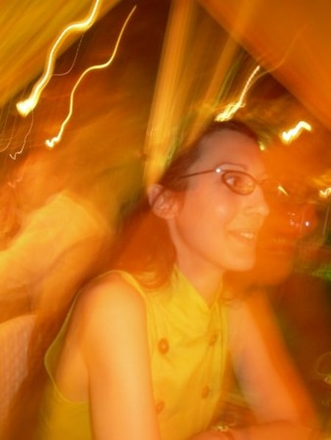


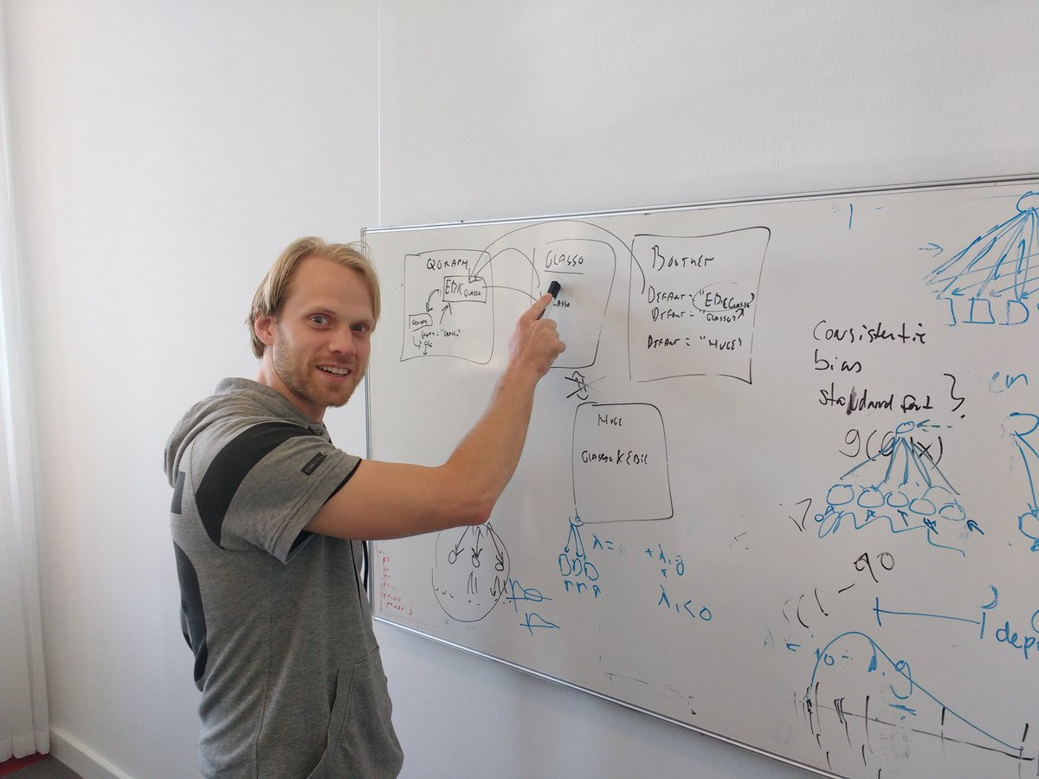



Thank you
Juliette Richetin
Erica Casini
Emanuele Preti
Sacha Epskamp
Eiko Fried
Marco Perugini
Rossella Di Pierro

