Slide 1
Food Waste Valorisation:
What about law?
monica.delsignore@unimib.it
Università degli studi di Milano Bicocca

Slide 2
Basic structure of the conversation
Evolution of Food law in EU and consequences in Food Waste
Waste Framework legislation
Food Waste Valorisation and Recovery Policy

Slide 3

1. Evolution of Food law in EU and consequences in Food Waste
From the MARKET APPROACH
to the SOCIAL APPROACH

Slide 4
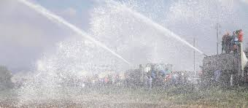
Market approach
’60 until first years of ’90
Food as a good : free movement in the internal market
CAP (common agricultural policy) contains measures influencing Food Waste Production

Slide 5

Social approach
BSE crisis: Human health protection and Trasparency are the new goals
Food safety and food security policies play an important role in Food Waste proliferation (aestethic standards, discard, proper storage facilities)

Slide 6
This underscores the need to find good and beneficial use for food and food waste, that is presently thrown away, in different ways:
- legislative: clarifying the meaning of expressions used in labels;
technological: finding new way for restoring Food Waste

Slide 7
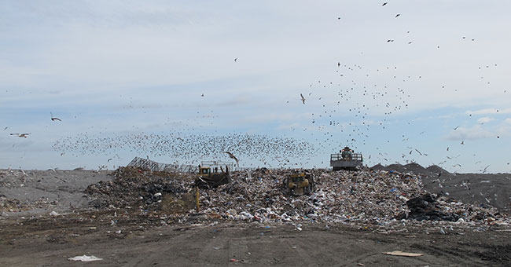
2. Waste Framework legislation

Slide 8
What is Food Waste?
Waste Framework Directive (2008/98/EC)
There is not a black and white distinction between materials that are not the main objective of a production process but can be considered as NON-WASTE BY-PRODUCTS and those that should be treated as WASTES

Slide 9
Who cares and why?
The Community’s waste management policy is underpinned by 3 keys objectives:
Prevention
Recovery
Safe disposal
This waste hierarchy must be put into effect by Member States.
To this end they may enact so-called extended producer responsibility schemes.

Slide 10

3. Food Waste Valorisation and Recovery Policy

Slide 11
RECOVERY as End-of-waste status is the key issue in this Costaction
Preparing for re-use
Material recovery
Energy recovery
Certain specific waste shall cease to be waste when it has undergone a recovery, including recycling, operation

Slide 12
The chemical and scientific progress must keep in mind the precautionary principle in their calculous of efficiency for real case application.
In general precaution is a legislative technique of enhanced protection, seeking to preserve a value even before a possible injury occurs (when it is not certain that it will occur and even if no damage may result in the end). The main function of the precautionary principle is to indicate the threshold above which uncertainty legally becomes equal to certainty and thus an action can be expected from governors

Slide 13
In the legislative perspective:
There must be attention in using financial incentives
Massive financial incentives (i.e. biofuels or green energy) can stop the scientific progress, directing the investments and preventing new strategies or implementation of new methodologies.

