Slide 1

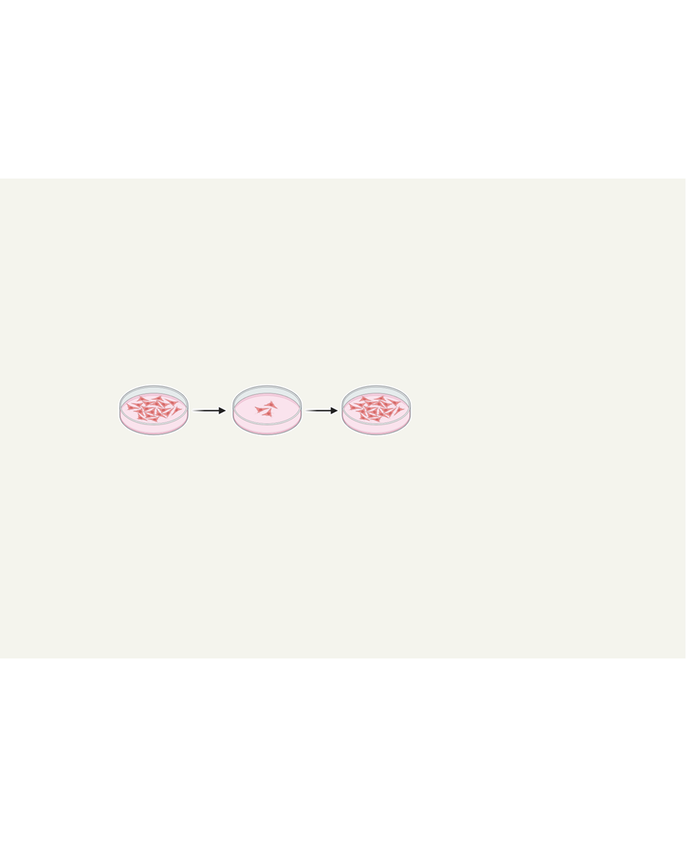
Effects of natural compunds on colorectal cancer cell lines
S. Bianchini¹, F. Bovio¹, F. Cristani¹, F. Guzzo², M. Forcella¹, P. Fusi¹
¹ Department of Biotechnology and Biosciences, University of Milano-Bicocca, Milan, Italy
² Department of Biotechnology, University of Verona, Verona, Italy
s.bianchini6@campus.unimib.it
Background
Screening
Colorectal cancer (CRC) is one of the most common types of cancer in the world. Surgery, chemotherapy and targeted therapy are part of the therapeutic armamentarium employed to tackle this disease, depending on the stage and molecular features. However, mortality for metastatic CRC remains high, urging the need for drug discovery and complementary approaches.
E705 and SW480 CRC and CCD 841 healthy colon mucosa cell lines viability was assessed after treatment with plant extracts. Of the 60 species tested, Diospyros kaki and Gratiola officinalis were selected for their cancer cell-specific toxicity.
A
B
AIM
Test and characterize plant extracts derived from different species for their possible anticancer activity and isolate drug-candidate compounds.
A, B. MTT results after treatment with D. kaki and G. officinalis extracts, respectively.
Results: D. kaki
Results: G. officinalis
D. kaki increases oxidative stress and disrupts mitochondrial functionality.
G. officinalis causes cell-cycle arrest in the SW480 cell line, while it induces apoptosis and impairs glycolysis in the E705 cell line.
A
B
C
D
A
B
C
A, B. Intracellular oxidative stress measured with the DCF-DA probe. C, D. Mitochondrial transmembrane potential evaluated with the DiOC6 dye.
A. Cell-cycle phases populations after propidium iodide staining. B. Apoptotic cell populations after Annexin V-PI staining. C. Glycolysis stress test.
Conclusions
Future perspectives
Identification of verbascoside as candidate molecule to further explore for the treatment of CRC.
Generation of a stable drug-resistant clone to assess verbascoside’s molecular mechanisms of action.
Continuous exposure to increasing doses of verbascoside
Selection of resistant cells
Phenotypic characterization of the drug-resistant clone.
Co-administration of verbascoside with clinically approved drugs to evaluate possible synergies.
MTT results after treatment with verbascoside.

