Slide 1


RESEARCH IN OUTER SPACE
Facilitating Access to Space Supporting Scientific and
Technological Advancement
By Matteo BARTOLINI¹⁾, David MORONI¹⁾, and Renato PANESI¹⁾
¹⁾D-Orbit, Italy

Slide 2
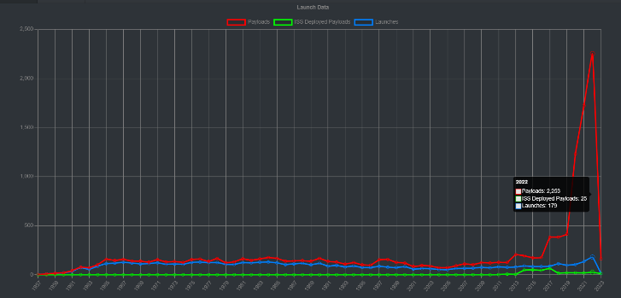
Introduction
The Concept of Space as a Service
Referring to Kara O’Donnell’s “Small Satellite Trending & Reliability 2009-2018”, Euroconsult predicted that about 7,000 SmallSats will be launched over the next decade (The next decade refers to 2018-2028): 580/year in 2022 and growing to 820/year by 2027.
The value of 580 satellites in 2022 became reality 2253, and the threshold year of 820 satellites per year by 2027 has been already reached and overtaken now

Slide 3
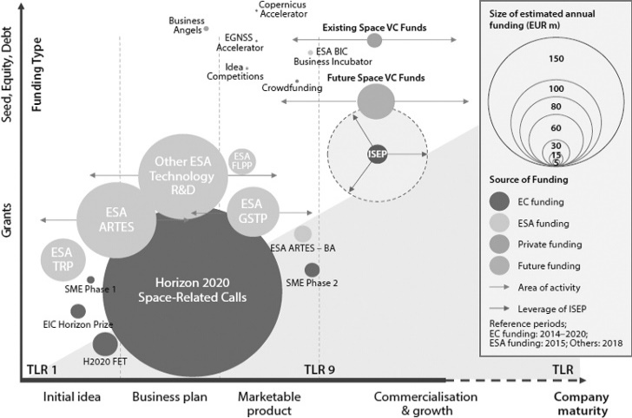
Introduction
Investment in Space
Citing Parrella, “Current pieces of evidence, then, show unprecedented investments from angel and VC funds in space start-ups and recently established firms, although the amounts still pale compared with public funding”.
It is interesting to notice that their target companies and technologies are those companies with a TRL of 4-5. These TRLs values are linked to the component and/or breadboard validation in a relevant environment

Slide 4
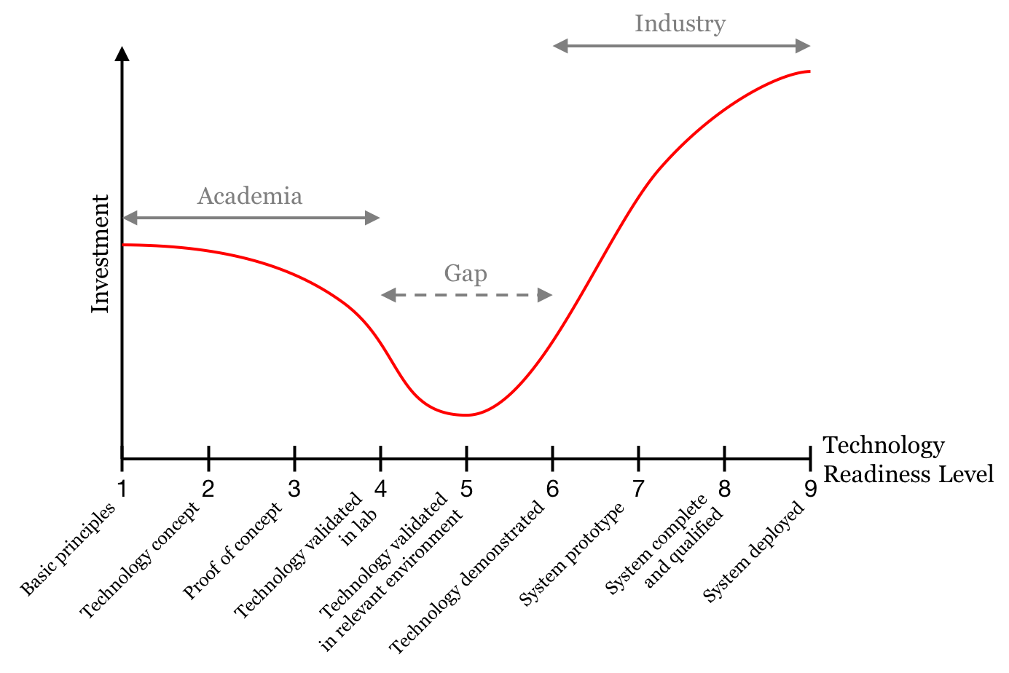
TRL – How to move ahead
Investment in Space
To quote the quarterly innovation of Boeing to depict how giant this leap is to achieve higher TRLs: “After TRL 6, there is a significant cost to mature the abilities of products and systems so that those seeking to use them can be confident that they will work as advertised. This cost and risk is the first part of the Valley of Death

Slide 5
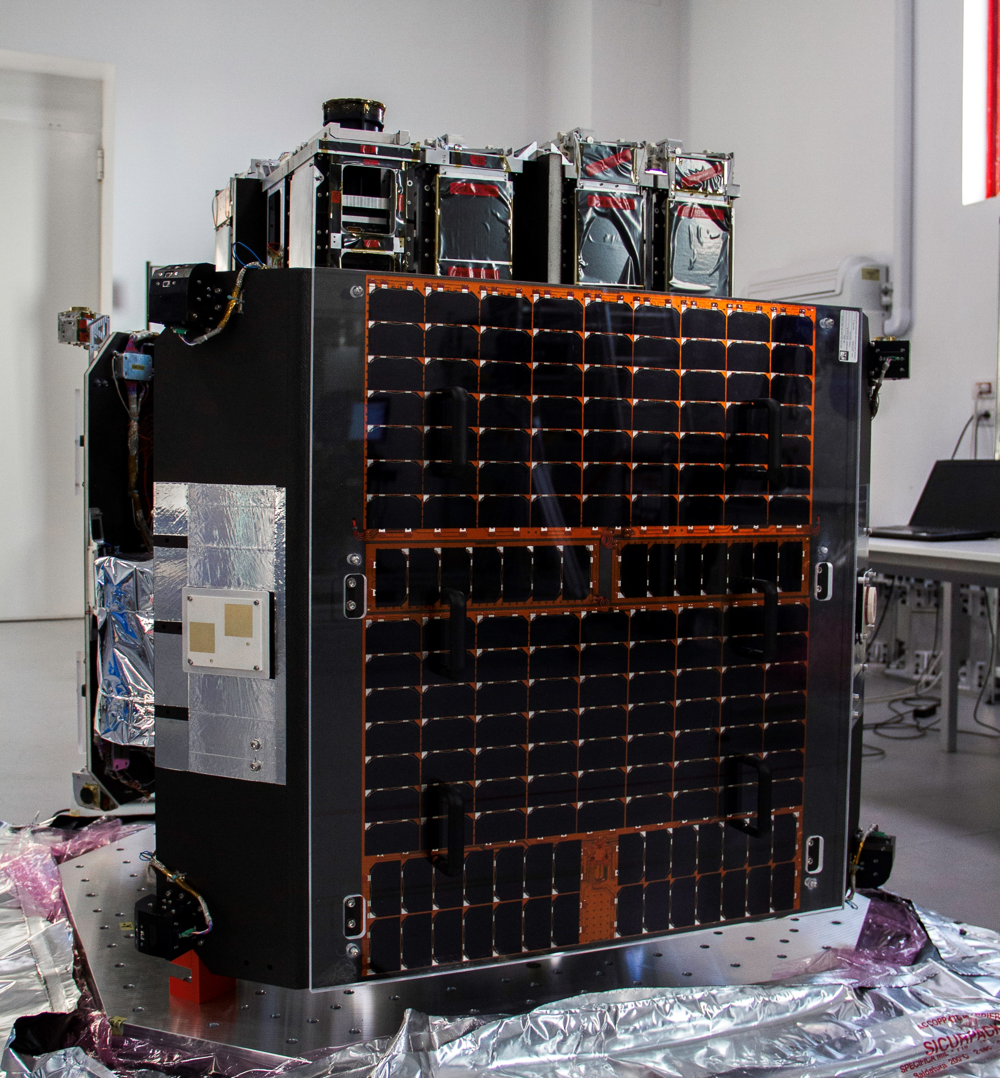
In-Orbit testing
Testing Technology in Space Through ION Satellite Carrier OTV
ION Satellite Carrier is composed of two modules:
The Platform which includes all the spacecraft subsystems and avionics
The Payload Bay is a fully configurable payload bay that can host separation rings for satellites, and CubeSat deployers and can provide mechanical, data and power interfaces for hosted payload
ION is able to perform any type of manoeuvre for on-orbit transportation services to payloads: altitude raising/lowering (e.g. deorbit), inclination change, true anomaly phasing, and LTAN/LTDN shift.

Slide 6
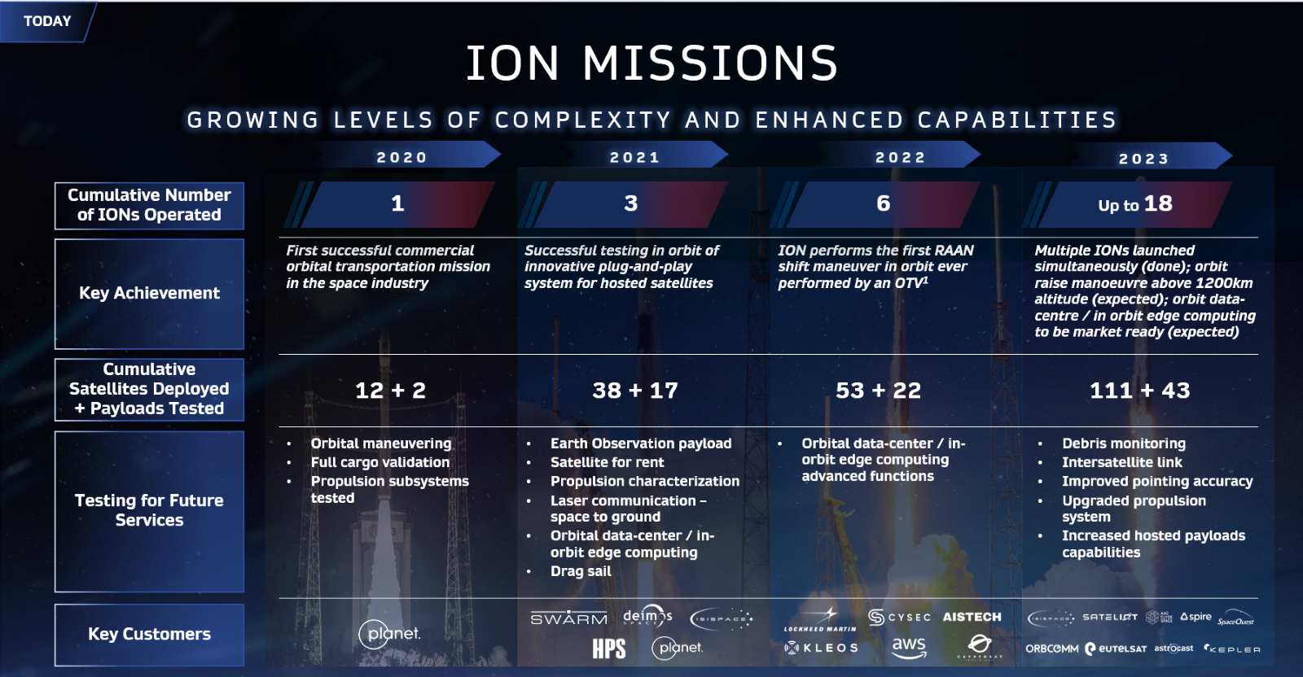
Testing Technology In Space
Testing Technology in Space Through ION Satellite Carrier OTV - Heritage

Slide 7
Testing Technologies in Space
Hosted Payload Performance
Power: ION Satellite Carrier provides peak and orbital average power to the customer-hosted payload, through several interfaces.
Data: along with the power interface, also data interface is provided to the hosted payload, allowing a bi-directional exchange of data and commands with the ION hosting platform to and from the hosted payload
Telecommunication: the data generated from the hosted technology is collected from the ION Satellite Carrier and then downloaded to ground through one of the ground stations provided by Ground Station As a Service (GSAS) providers.
On-Board Data Storage: the data generated from the customer’s technology can be as well stored on board in order to be post-processed or reused for comparison for the following test.
Pointing: ION can provide specific pointing accuracy if this is requested from the customer to test the technology properly.

Slide 8
Testing Technologies in Space
Hosted Payload Performance
Cloud Computing: ION Satellite Carrier is equipped with a dedicated flight computer specifically designed to run Machine Learning algorithms. This feature is designed for those customers willing to post-process the data directly in orbit, without the need of downloading a large amount of data, to be analyzed on the ground. Practical applications include:
Civil security and public protection: Object detection (illegal shipping, piracy, smuggling, etc.); crowd location and detection; atmosphere and pollution alert.
Disaster monitoring and response: Real-time detection (wildfires, floods, landslides, avalanches, traffic accidents, tsunamis); real-time alerts (directly to ground and via network to authorities); real-time response support; cross-task other satellites (e.g. targeted observation for a passing commercial SAR)
Climate and weather monitoring: Detection of dangerous weather events; prioritization of data inputs into model ensembles to obtain earlier and better forecasts

Slide 9
TRL – What’s next?
In Orbit Transportation
(Lord, Peter, et al, 2019) TRL 10, defined as reliable Flight Proven Technology, it can be quantified by having at least 5 flights of the same production technology without anomalies.
(Lord, Peter, et al, 2019) For TRL 11, defined as Mature Flight Proven Technology, the technology should have demonstrated only a single or no anomaly at all over 15 flights.
ION Satellite Carrier could be seen as an extension of a test facility in space that customers rely on gain heritage and to reach the minimum flight heritage to mark TRL 10 or 11 as their products.

