Slide 1




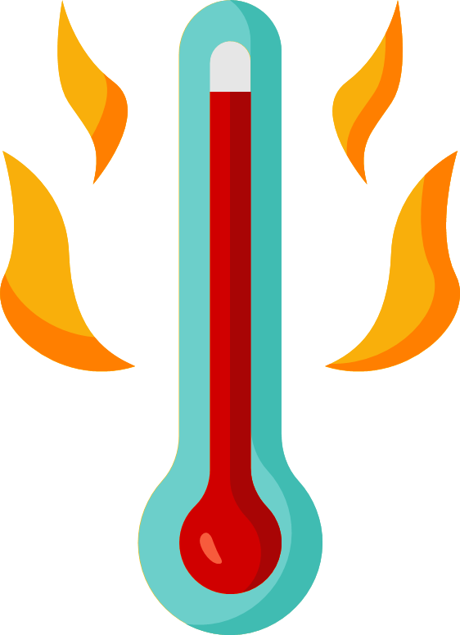

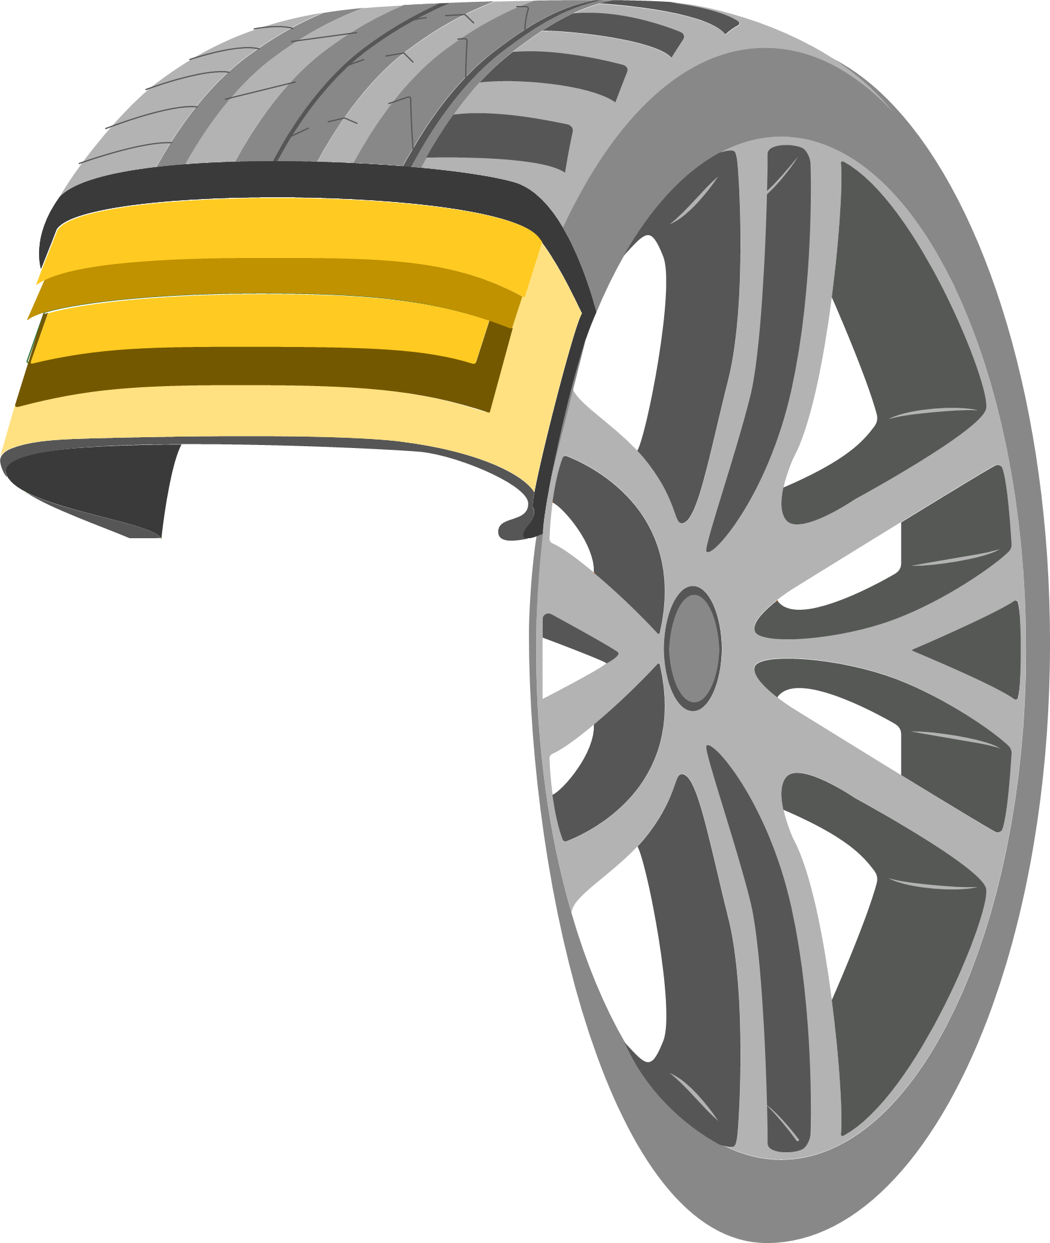





Biotic and Abiotic degradation of rubber compounds: establishing a baseline and assessing the changes on rubber surface and bulk
Alessia Dicesare^{1,2}, Daniela Bucchieri^{1,2}, Marcella de Divitiis^{1,2} , Immacolata Serra¹, Paola Branduardi¹
¹ Department of Biotechnology and Biosciences, University of Milano-Bicocca Piazza della Scienza 2, 20126, Milano, Italy,
² Department of Material Science and Nanotechnology, University of Milano-Bicocca Via R. Cozzi 55, 20125, Milano, Italy
Synthetic polymers & actual regulations
Among synthetic polymers, plastics dominate over rubber-like materials. As a result, extensive efforts have been made to study plastic degradation, leading to the development of international standards for assessing their degradation and biodegradability. In contrast, our understanding of elastomeric polymers degradation remains limited. Recently, Tyre and Road Wear Particles (TRWPs) have received growing attention.
Background:
TRWPs origin & dispersion
Experimental approach
Given the limited understanding of how degradation affects pristine vulcanized rubber compounds (not pure elastomers), we present a multidisciplinary approach to study their photo- and biodegradation in film form.
TRWPs consist of tread-derived materials mixed with road-origin particles. The majority of TRWPs accumulate in soil, while a smaller fraction is released into surface waters.
66-76% → soil
12-20% → surface
waters
Abiotic degradation
Photo-oxidation, the main weathering process affecting TRWPs, was used to simulate environmental ageing of rubber compounds, via UV irradiation.
Background: previous studies
Biotic degradation
Microbial consortia were enriched from soils potentially exposed to TRWPs by using rubber compounds as the sole carbon source, promoting the growth of polymer-degrading communities.
Tyre treads are typically made of complex formulations based on elastomeric polymers. Recent studies have investigated the biodegradability of pure elastomers. These confirmed significant biodegradation of NR, while SBR and IR showed negligible biodegradation rates.
NR
SBR
IR
Bulk & surface analyses
Milled rubber from used tyres or pure elastomers does not fully represent the complexity and heterogeneity of actual TRWPs.
SEM imaging
FT-ATR IR
NOT FULLY
REPRESENTATIVE
Weight-loss
TGA
Plastiche & Ambiente
Ravenna, June 5–6, 2025
CONTACT ME!
a.dicesare3@campus.unimib.it
Università degli Studi di Milano-Bicocca, P.zza della Scienza, 4 - 20126 Milano, Italy
0264483439, PhD student in Material Science
WEBSITE

