Slide 1



Thermal preconditioning postpones coral bleaching by inducing an antioxidant response and cellular defense mechanisms in two coral species, Pocillopora damicornis and Stylophora pistillata.
Madaschi A.^{1,2*} , Louis Y.D.^{1,2,3}, Montalbetti E.^{1,2,3}, Isa V. ^{1,2,4}, Maggioni D.^{1,2,3}, Pravettoni L.^{1,2}, Pollutri R.^{1,2}, Bises C.^{1,2}, Cerri F.^{1,2}, Gobbato J.^{1,2}, Galli P.^{1,2,3}, Montano S.^{1,2,3}, Seveso, D.^{1,2,3}
¹ Earth and Environmental Science Department, University of Milano Bicocca, MI 20126, Italy
² MaRHE Center (Marine Research and High Education Center), Magoodhoo Island, Faafu Atoll, Maldives
³NBFC (National Biodiversity Future Center), 90133 Palermo, Italy
⁴ Costa Edutainment SpA - Acquario di Genova, GE 16128, Italy
* Presenting author e-mail: a.madaschi1@unimib.it
Notes:
Goodmorning everyone,
I’m Andrea Madaschi, PhD student of the University of Milano-Bicocca
Today I’ll show interesting developments in thermal preconditioning research on the corals Pocillopora Damicornis and Stylophora pistillata

Slide 2
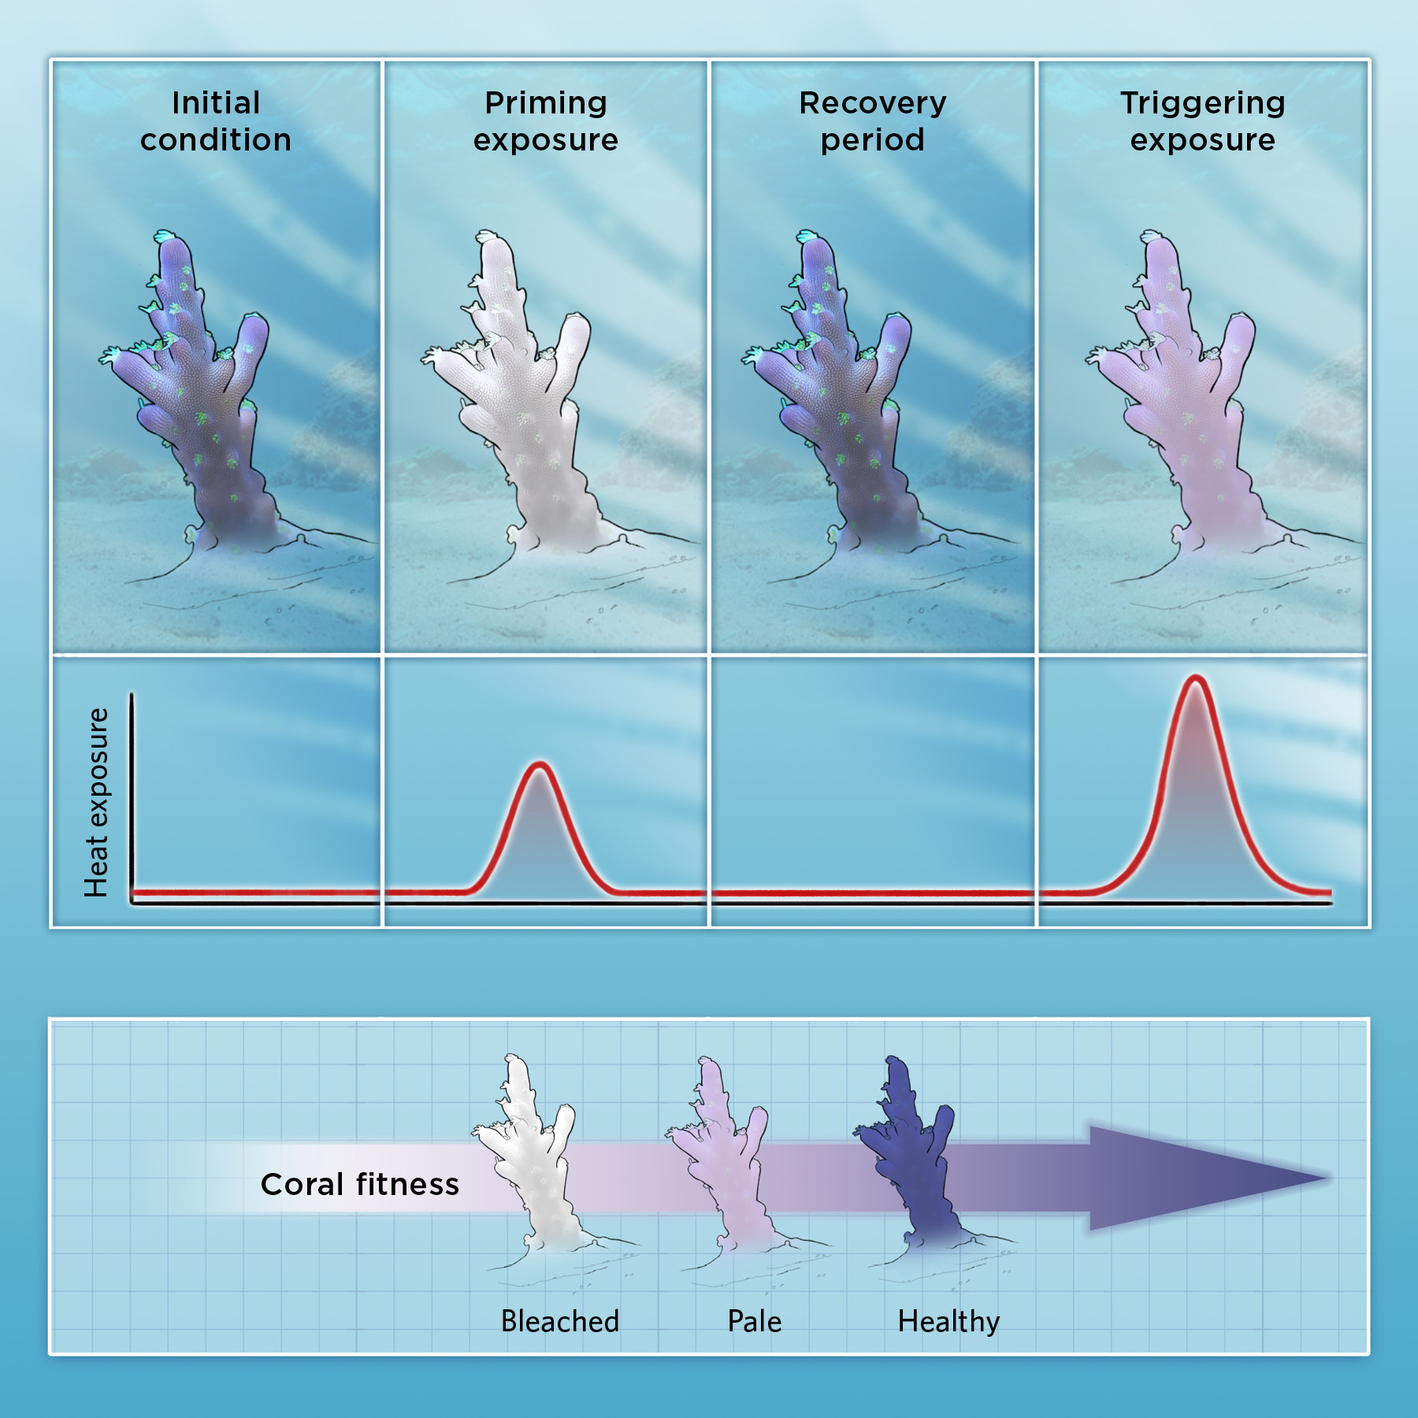
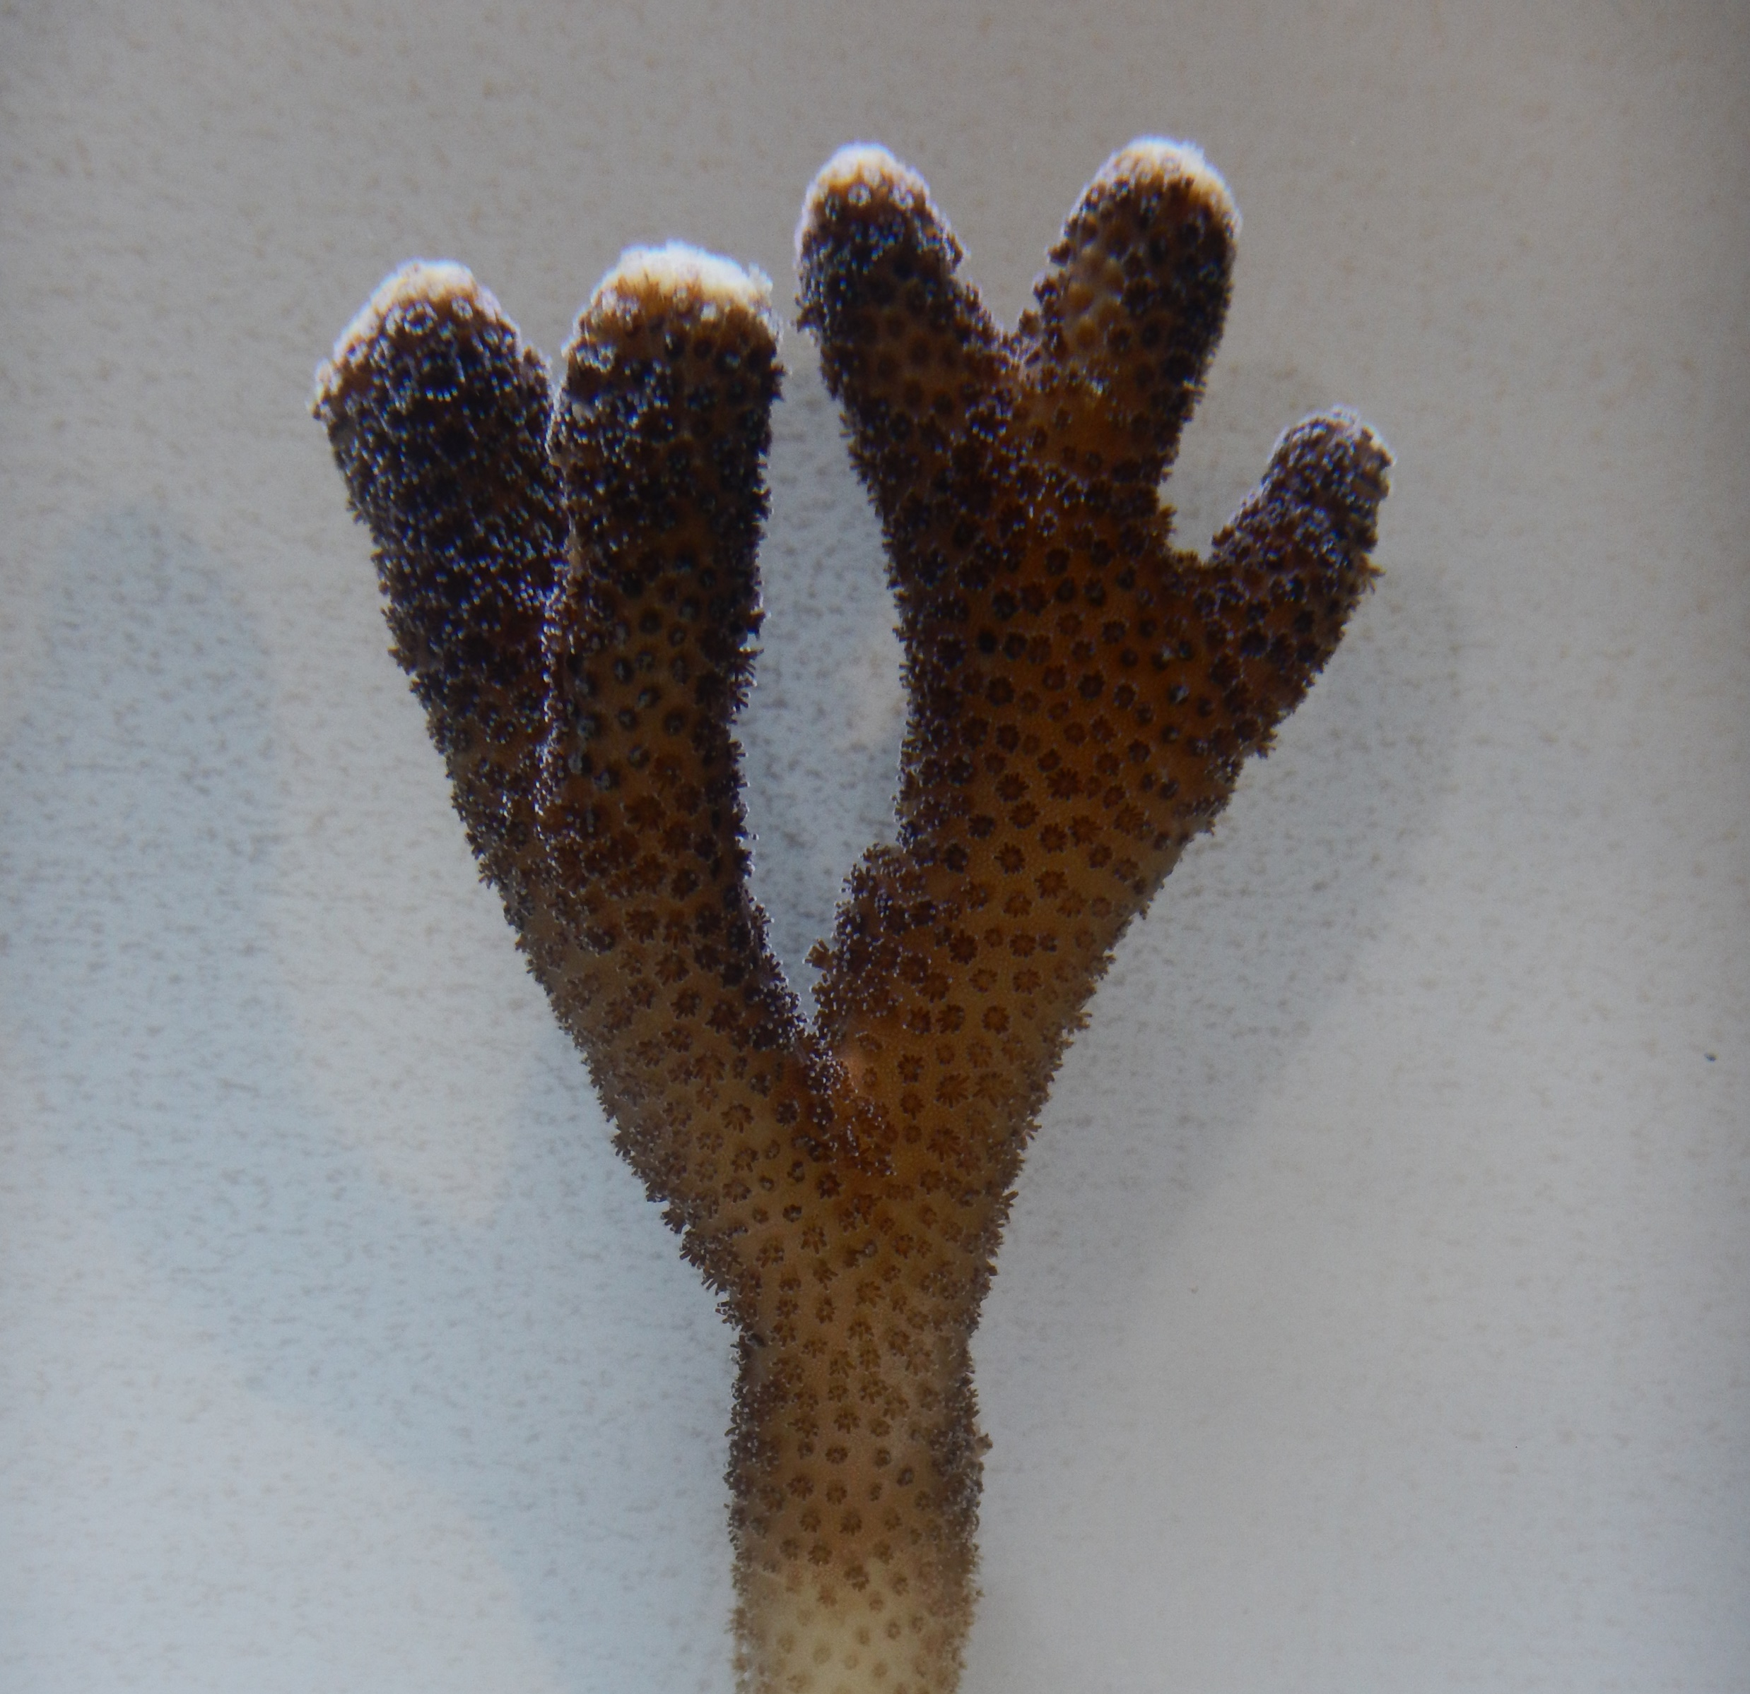
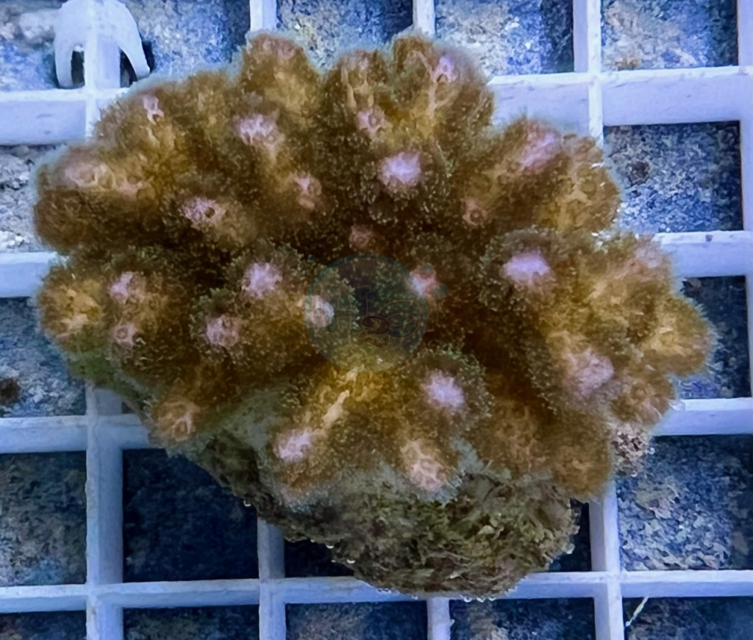
Introduction
THERMAL PRECONDITIONING
Sub-lethal temperatures were applied on corals for a short period of time (7 days)
AIM OF THE STUDY
Investigate chlorophyll a and c2 concentrations and antioxidant enzymes activity of thermally preconditioned Pocillopora damicornis and Stylophora pistillata.
Enhancing coral’s
thermal resilience
Pocillopora damicornis
Stylophora pistillata
© CATHERINE DELPHIA; ADAPTED FROM TRENDS ECOL, 36:1011–23, 2021
https://www.h2oacquari.it/h2o/93-coralli-sps
Notes:
Thermal preconditioning
Thermal preconditioning is the technique that involves the application of sub lethal temperature on corals for limited time ( usually 7 days)
The goal is to enhance coral’s thermal tolerance against thermal stresses → against coral bleaching
Therefore in this study we have analyzed the response to thermal preconditioning
AIM OF THE STUDY
Investigate chlorophyll a and c2 concentrations and antioxidant enzymes activity of thermally preconditioned Pocillopora damicornis and Stylophora pistillata.

Slide 3
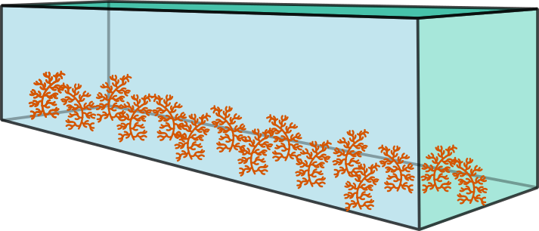
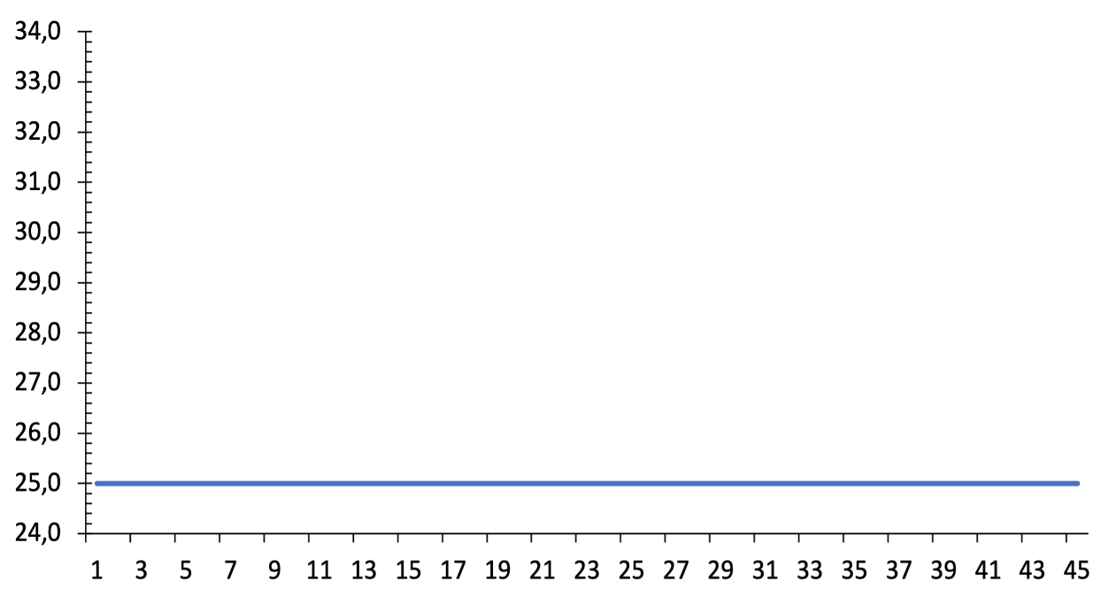
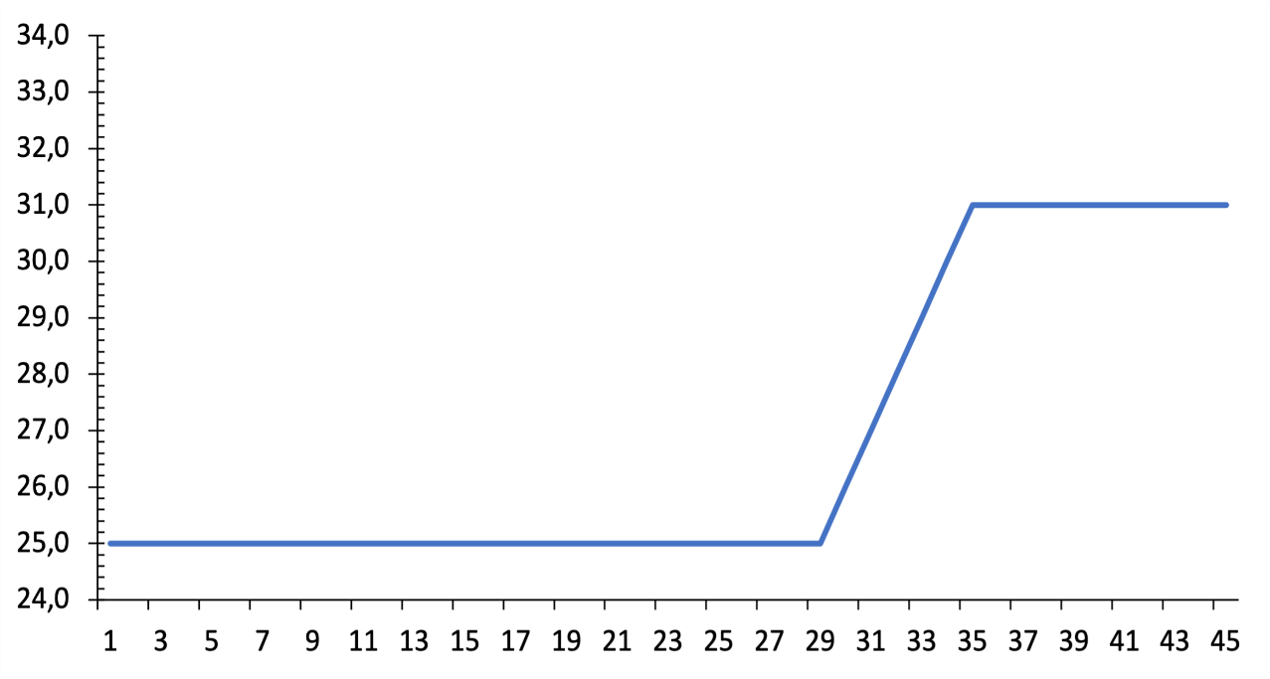
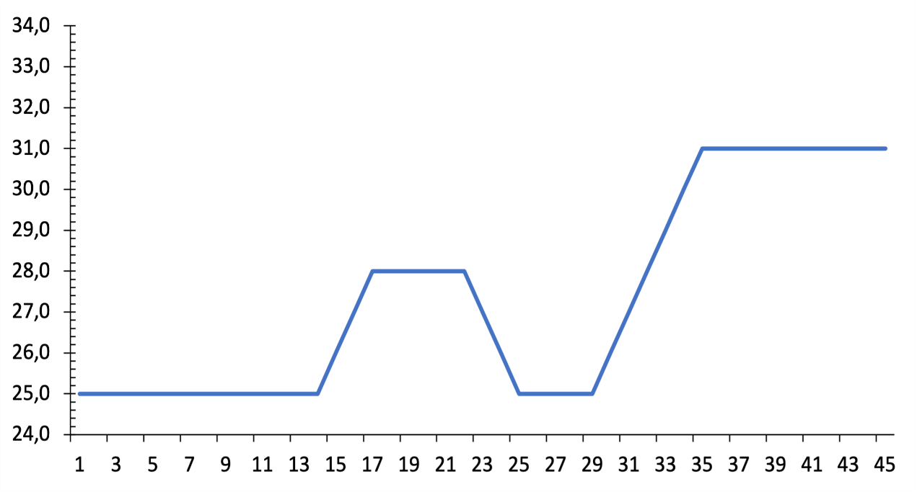
Methodology
Control (C)
25°C Constant temperature throughout the entire experiment
Control
NPC
Non Preconditioning(NPC)
T° max 31°C
Bleaching conditions simulation
Preconditioning
Preconditioning (PC)
7 days at 28°C, increase decrease ratio 1°C/day
298 Kmq
4 samplings (No stress, 24h, 72h, 240h)
Notes:
3 DIFFERENT THERMAL PATTERNS

Slide 4
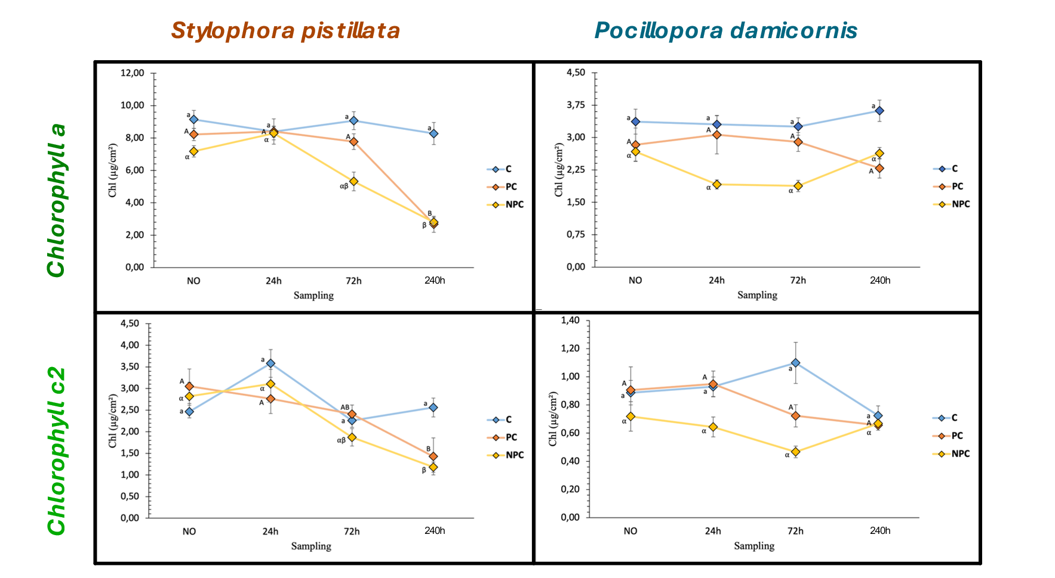
Results
CHLOROPHYLL a & CHLOROPHYLL c2
Preconditioned Pocillopora damicornis corals maintain their concentration of both pigments. After 72 h, a slight decline occurs, which is not statistically significant.
Preconditioned Stylophora pistillata , corals maintain both Chl a and Chl c2 [] up to 72 h, then both pigments decline rapidly ( p< 0,05)

Slide 5
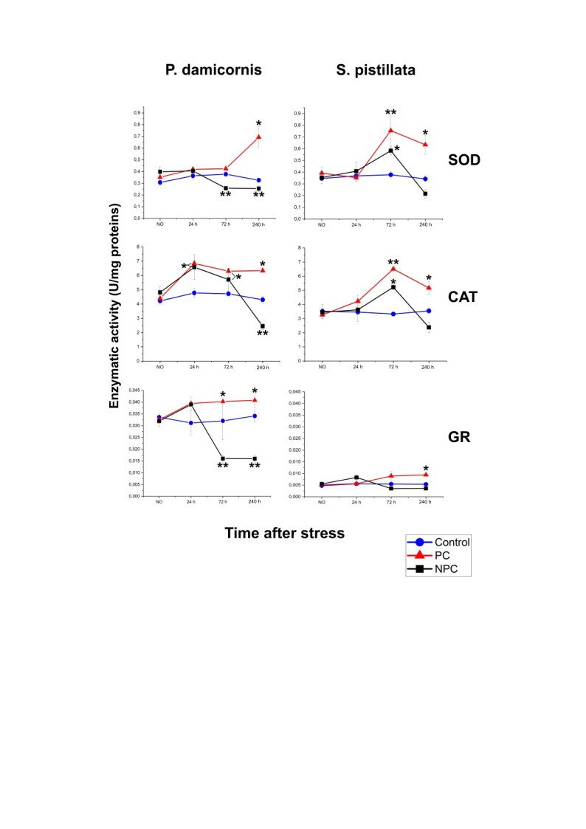
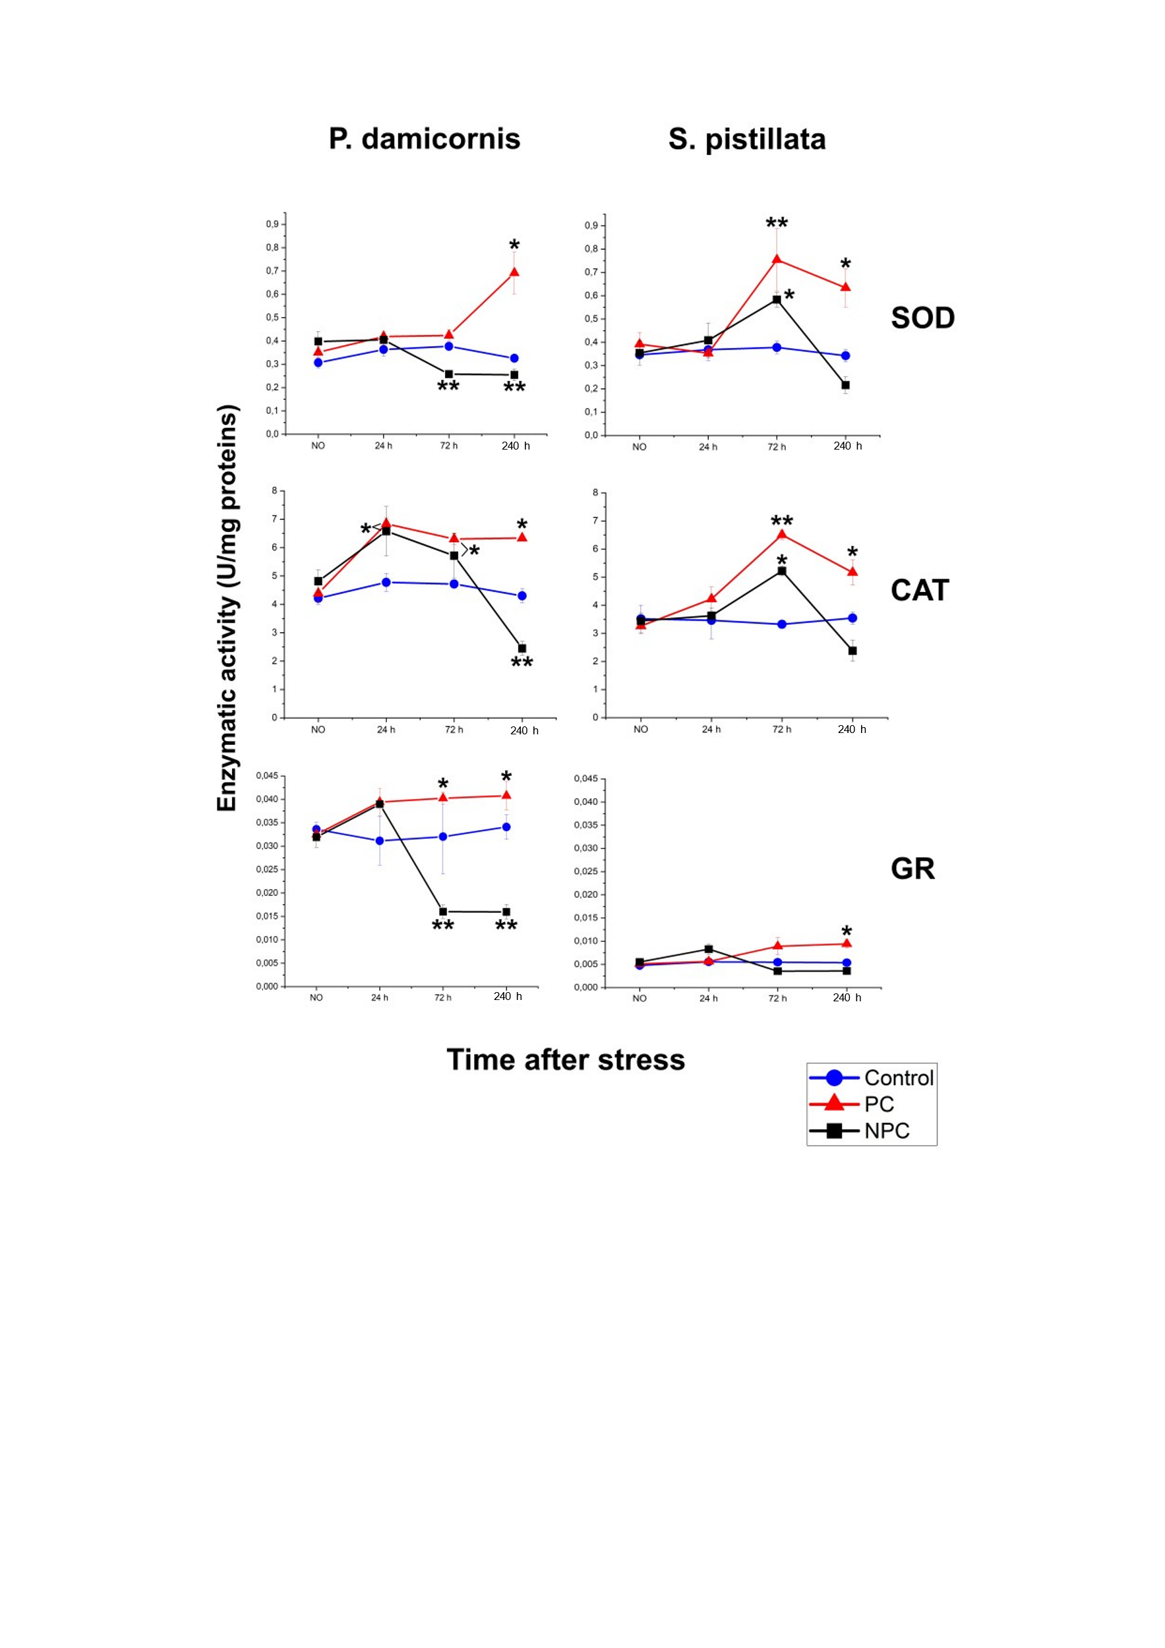
Results
Antioxidant activity
Stylophora and Pocillopora thermally preconditioned nubbins higher SOD activity compared to control and NPC.
Up to 72 h, all three enzymes show increased activity levels in PC compared to both control and NPC corals.
NPC nubbins decreased activity in all antioxidant enzymes after 72 h

Slide 6
Conclusions
Main hypothesis confirmed: thermal preconditioning delays the appearance of negative effects correlated to high-temperature exposure of Pocillopora damicornis and Stylophora pistillata
  Thermal preconditioning increases thermal resistance up to 72 hours from stress start
  SOD, CAT, and GR appear to be activated simultaneously to counteract thermal stress.
  Future perspectives: Analyzing LPO and Hsp70, merge thermal and chemical preconditioning.

Slide 7
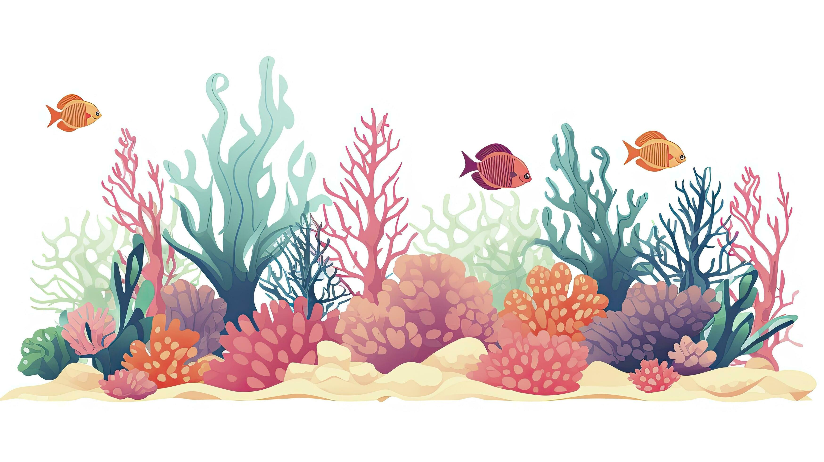
THANK YOU FOR YOUR ATTENTION

Slide 8
Acclimatisation
•25 °C/2 weeks
•
Preconditioning
•Ramp:1°C/day
•Max temp: 28°C/7 days
•Recovery: 5 days
•
Thermal stress
•Ramp: 1°C/day
•Max temp: 32°C
Sampling
•5 days after Pre-Cond.
•1 day after Heat stress
•3 days after Heat stress
10 days after Heat stress

Slide 9
This slide is an editable slide with all your needs.
This slide is an editable slide with all your needs.
Before stress
72h
24h
168h
This slide is an editable slide with all your needs.
This slide is an editable slide with all your needs.

