Slide 1








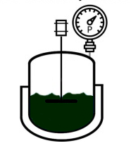
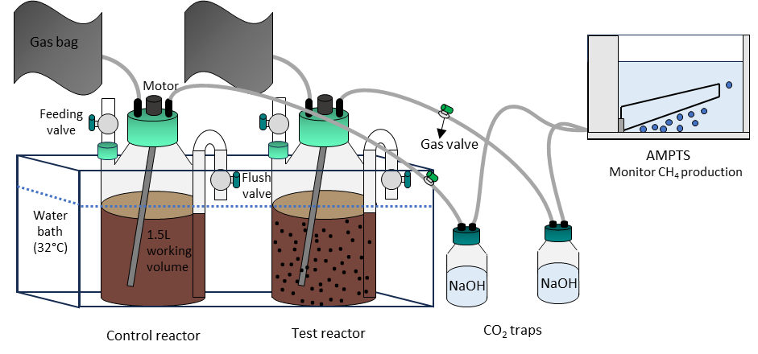
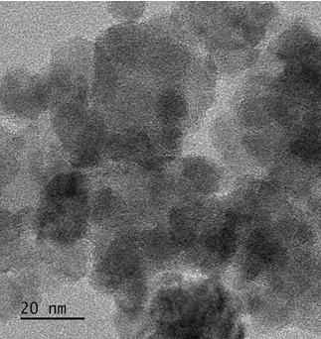


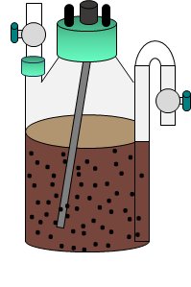


Young Algaeneers Symposium.
Vannes, Brittany 27-30th May 2024
Optimization of anaerobic digestion using microalgal-based iron nanoparticles
Elena Passalacqua¹, Marco Mantovani¹, Elena Collina¹, Elena Ficara², Valeria Mezzanotte¹
e-mail: e.passalacqua@campus.unimib.it
¹ Università degli Studi di Milano - Bicocca, Dept. of Earth and Environmental Sciences, Piazza della Scienza 1, 20126 Milano, Italy
² Politecnico di Milano, Department of Civil and Environmental Engineering, Piazza Leonardo da Vinci 32, 20133 Milano, Italy
This research focuses on using microalgal-based carbon-encapsulated iron nanoparticles to enhance the anaerobic digestion process of municipal sludge. The study aims to increase sludge digestion efficiency, boost methane production, and reduce the formation of undesirable compounds such as carbon dioxide (CO₂) and hydrogen sulfide (H₂S).
Methods
Scope
The nanoparticles were synthesized through hydrothermal carbonization (HTC) using microalgae as feedstock.
Fe(NO₃)₃ ∙9H₂O
HTC:
225°C, 3h
The nanoparticles have been characterized to understand their morphology (TEM, SEM), composition (EDX), surface area (BET analysis), and crystalline phases (XRD).
The effect of nanoparticles on anaerobic digestion was evaluated using two semi-continuous reactors with 21-day HRT. In the test reactor, nanoparticles are added at a 0.1 mg/L concentration. Higher dosages will be evaluated depending on the obtained results. Thanks to their magnetic properties the nanoparticles are recovered weekly during the discharge operations and subsequently reintroduced into the digester along with the fresh sludge.
The amount of biogas produced is continuously monitored using AMPTS systems, while the composition is determined weekly through gas chromatography analysis.
The sludge used to feed the reactors and the resulting digestates are characterized in terms of physico-chemical composition every week. Samples have been collected to perform genomic analysis (qPCR)
Preliminary results
The nanoparticles exhibit a spherical shape with a 9.20 ± 2.96 nm diameter. XRD analysis showed the presence of characteristic peaks related to iron oxide, including hematite (Fe₂O₃) and magnetite (Fe₃O₄), providing magnetic properties to the nanoparticles. EDX analysis revealed the presence of iron, carbon, and oxygen within the nanoparticles, along with magnesium, phosphorus, and calcium deriving from microalgae biomass.
Expected results
Improved buffering capacity
Biogas increased and high CH₄ content
Nanoparticles at TEM microscope
Amelioration
of Archea community
Enhancement bacteria community
After a stabilization period of 1 HRT, 0.1g/L of nanoparticles were introduced into one of the two reactors, called Test.
Following the addition of nanoparticles, after approximately 2.3 HRT, biogas production was higher in the Test reactor compared to the Control (245 ± 67 and 182 ± 39 NmL/gVS, respectively). However, the biogas percentage composition in the two reactors was not statistically different.
Facilitation of the DIET process
Increased hydrolysis rate
e⁻
e⁻
References
Feng, Y., Zhang, Y., Quan, X., Chen, S., 2014. Enhanced anaerobic digestion of waste activated sludge digestion by the addition of zero valent iron. Water Res 52, 242–250. https://doi.org/10.1016/j.watres.2013.10.072
Mantovani, M., Collina, E., Lasagni, M., Marazzi, F., Mezzanotte, V., 2022. Production of microalgal-based carbon encapsulated iron nanoparticles (ME-nFe) to remove heavy metals in wastewater. Environmental Science and Pollution Research 30, 6730–6745. https://doi.org/10.1007/s11356-022-22506-x
Peng, L., Ren, Y., Gu, J., Qin, P., Zeng, Q., Shao, J., Lei, M., Chai, L., 2014. Iron improving bio-char derived from microalgae on removal of tetracycline from aqueous system. Environmental Science and Pollution Research 21, 7631–7640. https://doi.org/10.1007/s11356-014-2677-2
CH₄
CO₂
N₂
O₂

