Slide 1

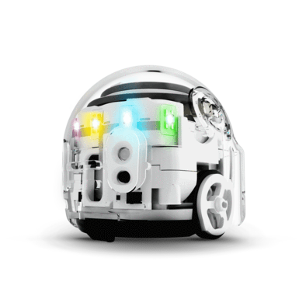
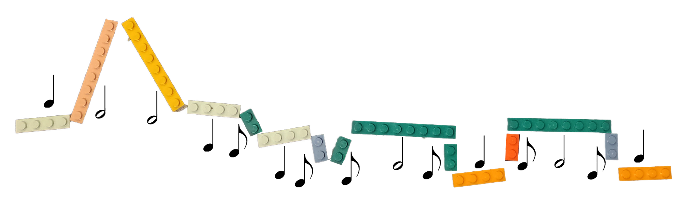
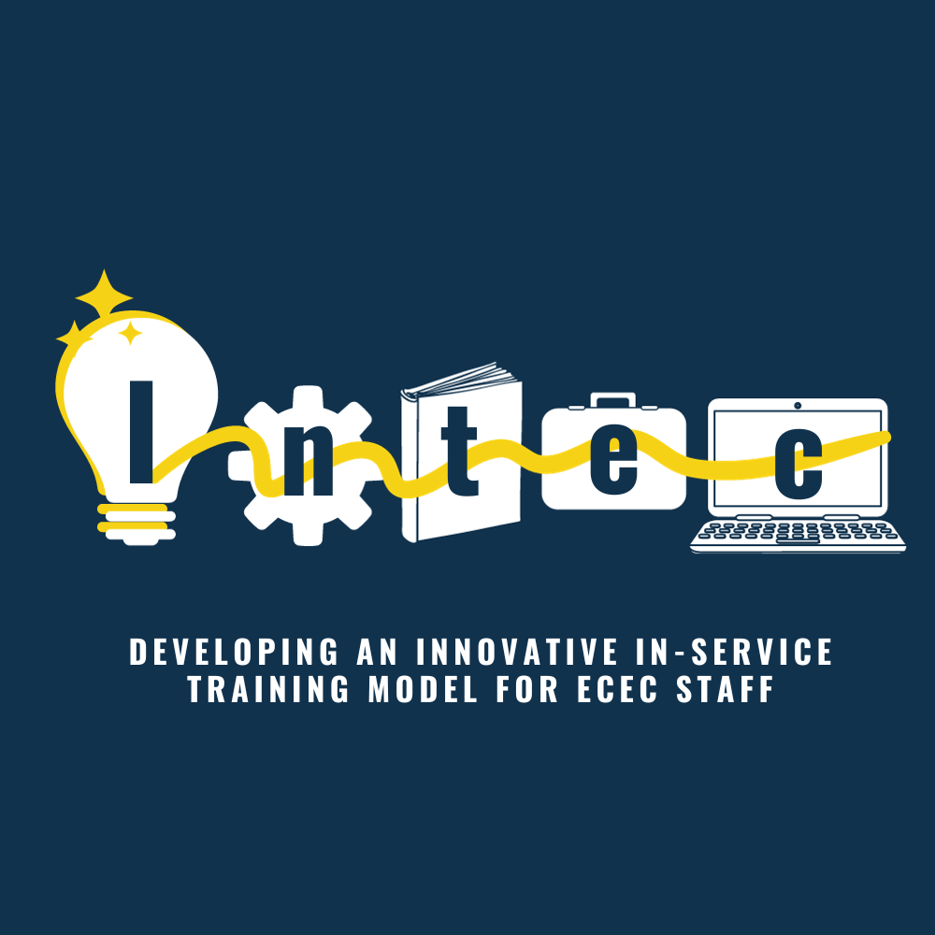



MuMaBot: weaving disciplines, languages and ideas in STEAM
Maddalena Cocco, Tecla Morettin, Anna Mortara and Luisa Zecca
Notes:
The aim of this study is to evaluate a training course conducted on an innovative STEAM methodology that interweaves music, mathematics and educational robotics with ECEC professionals (Early Childhood Education and Care, meaning services working with children aged 0 to 6) .

Slide 2
CONTEXT
INTEC - Developing an innovative in-service training model for ECEC staff
Literature review
European guidelines
National references
Transnational In-service Training Curriculum (TITC)
Intertwining theory and practice
Learning communities
Collaborative learning and reflection
Situated approach
Erasmus+ Key Action 2 - Cooperation Partnerships in School Education
Pr. nr.: 2023-1-SE01-KA220-SCH-000156400
MUMABOT
training course
Notes:
The MUMABOT course was one of the pilot training courses developed for the Erasmus+ Key Action 2 project “INTEC - Developing an innovative in-service training model for ECEC staff”
Project partners are the Municipality of Vänersborg (Sweden), SERN - Sweden Emilia Romagna Network (Italy), the University of Vic (Spain), RTU Liepāja (Latvia), Fondazione Bambini Bicocca (Italy), and Erasmus Hogeschool Brussels (Belgium).
The project's primary focus was the development of the Transnational In-Service Training Curriculum (TITC), which aims to establish a European framework based on shared values ​​and pedagogical approaches to support transnational learning experiences.
The work group conducted a literature review of scientific publications from the previous five years on the topic of continuous professional development in the ECEC sector, examined European guidelines for continuing professional development, and compared official national references for in-service training in the research partner countries.
This analysis highlighted several key aspects regarding the design and evaluation of in-service training:
the constant intertwining of theoretical elements and practical activities
the creation of learning communities
collaborative learning and reflection
situated learning
and the flexible use of different learning strategies.

Slide 3
STEAM IN ECEC SETTINGS
POTENTIAL IMPACT
Provide settings in which children can actively engage in constructing knowledge
Support the development of critical thinking, problem-posing and problem-solving skills
BARRIERS
Difficult to implement
Need for training and support
FACILITATING APPROACHES
Multimodal (Tomlinson, 2013; Ludovico et al. 2017)
Transdisciplinary (Areljung, 2023)
Notes:
For the Mumabot course the topic of STEAM was explored in the literature, highlighting on one hand the possibilities offered by these kind of activities:
Can help develop critical thinking, problem-posing and problem-solving skills
Can support the holistic development of the children, by connecting artistic and scientific knowledge through play.
On the other hand, the research described
A declared difficulty for ECEC professionals to implement this type of activity in their services
and the need for training and support
it also presented the possibilities offered by a multimodal and transdisciplinary approach to give better access to knowledge, by allowing children multiple channels of entry to the themes explored.

Slide 4
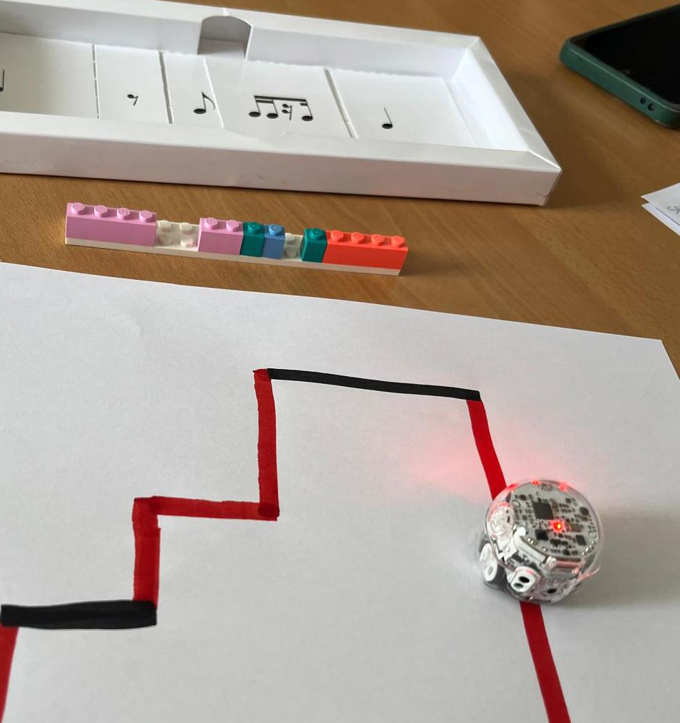
MUMABOT METHODOLOGY
MUSIC
MATHEMATICS
EDUCATIONAL ROBOTICS
Transdisciplinary
Contamination zones
New arenas of knowledge
Didactic mediators
Rhythm Box
Lego bricks
Ozobot
Multimodal
Multiple sensory channels
Symbolic-cultural systems
Notes:
Mumabot (MUsic, MAthematics and educational roBOTics) is an innovative transdisciplinary and multimodal methodology that combines these three disciplines to make complex concepts in music,
mathematics, and robotics accessible.
It involves a laboratory approach, where children can find multiple ways to understand the topic and express themselves, and the use of educational mediators (the Ozobot robot, Rhythm Box cards, and Lego bricks) .
What do we mean by transdisciplinary and multimodal approach?
Transdisciplinary means working in the contamination zones between the different disciplines, identifying concepts that can be explored through the lens and the tools of the individual disciplines to generate a new arena of knowledge.
Multimodal means including in the activity plan and implementation multiple sensory channels of access, and using tools, artefacts and symbolic systems that are culturally relevant.

Slide 5
MUMABOT LOCAL PILOT
Milan, Italy. February 8th-May 17th 2025.
5+5 hours
in person meetings
training on the content and methodology
12 hours
on the job implementation
with feedback from trainers
3 hours
online closing meeting
to discuss the implementation phase
34 trainees from Bambini Bicocca Foundation Participants:
13 infant-toddler’s center educators (0-3)
12 preschool teachers (3-6)
2 primary school teachers (6-11)
5 music specialists (0-3, 3-6 or 6-11)
1 infant-toddler’s center coordinator
1 preschool coordinator
Notes:
The Mumabot training course was piloted in a local version, conducted in Italian, and an intensive international version, conducted in English.
The local version took place in Milan, Italy, from February 8 to May 17 2025, for a total duration of 25 hours.
These 25 hours were divided in two 5 hours in person meetings, 12 hours of on the job implementation by the trainees, and a 3 hours online closing meeting.
There were 34 participants: 13 infant-toddler’s center educators, 12 preschool teachers, 2 primary school teachers, 5 music specialists working with either 0-3, 3-6 or 6-11 years old children and 2 pedagogical coordinators (one from an infant-toddler’s center and one from a preschool).

Slide 6
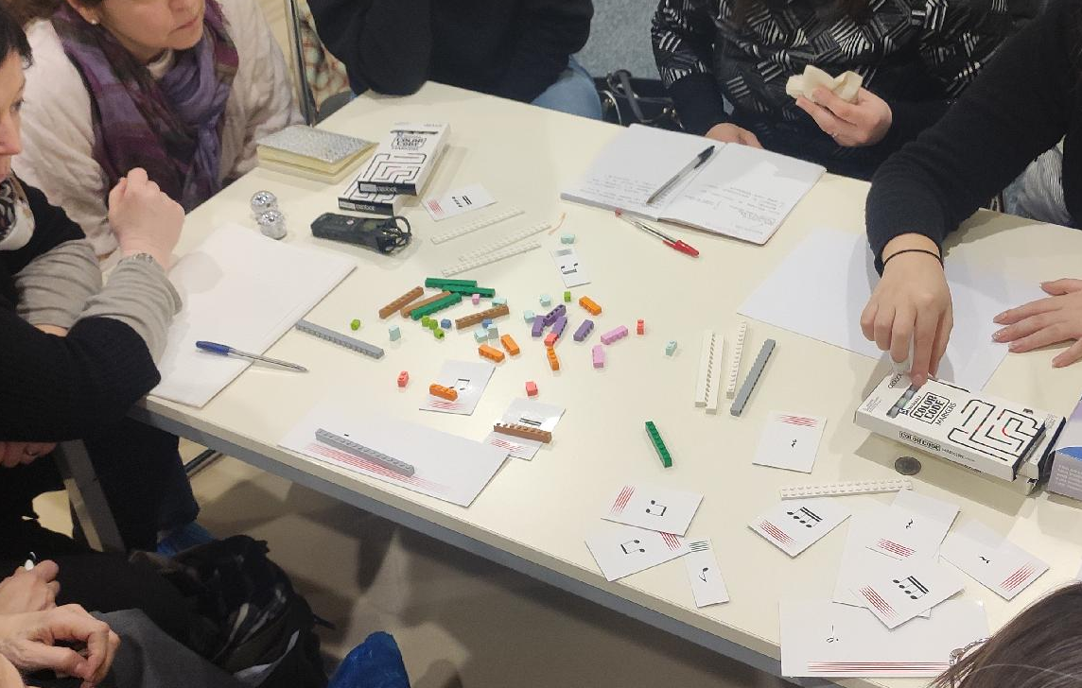
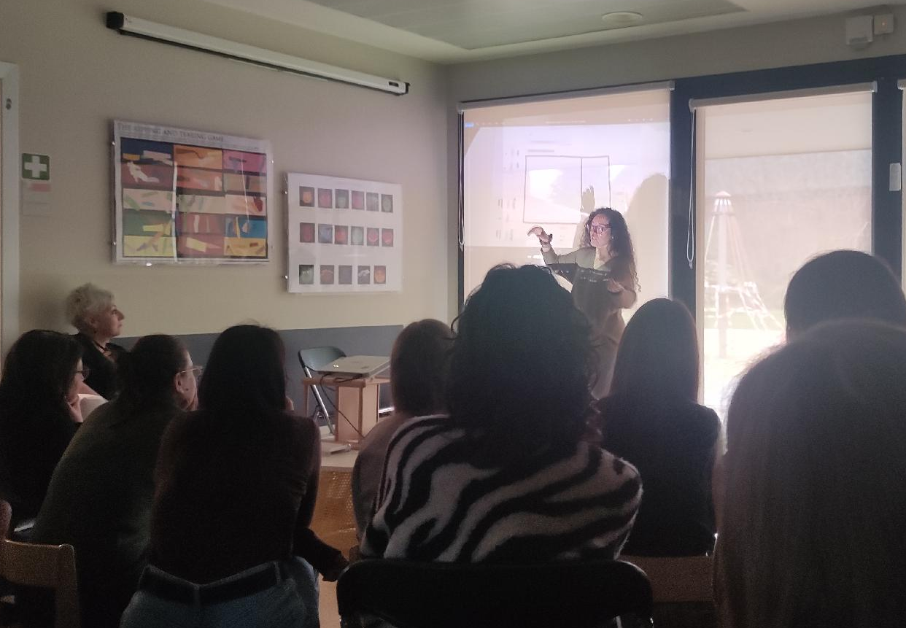
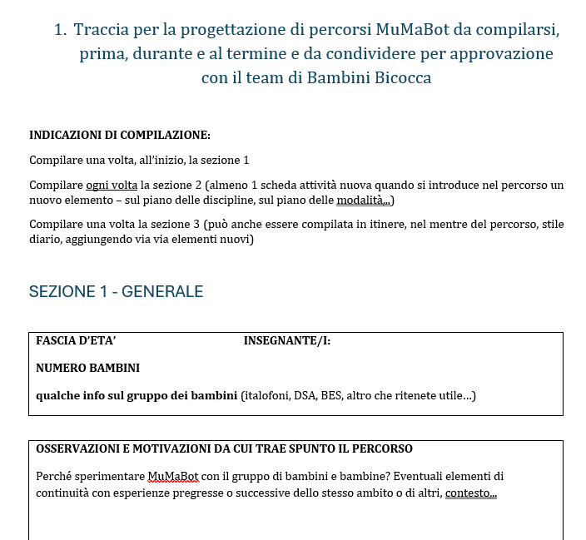
INITIAL TRAINING
EXPERIENTIAL ACTIVITIES
SHARING AND REFLECTING
PLANNING
Notes:
During the two face-to-face meetings, the trainees experienced Mumabot activities firsthand, working in small groups that were diverse in terms of their professional roles and the services they worked in.
These experiential activities were accompanied by an introductory session on the theoretical foundations of the approach, and several large-group sessions for sharing and reflecting on what happened during the small group activities.
The final part of the second meeting focused on the use of the design and documentation sheet provided to the trainees to use in the implementation phase in their services
and included a group session during which the trainees began planning how they would introduce the activities to the children.

Slide 7
ON THE JOB IMPLEMENTATION
RAF (RECHERCHE-ACTION-FORMATION)
Contributing to pedagogical knowledge
Bringing out a change in the practice
Generating a transformation
  Teachers and educators as co-researchers
STRUCTURE
From March to May 2025
Contextually situated planning
Participants received a Mumabot kit (Ozobot + Rhythm Box)
Microsoft Team as a platform
Online closing meeting

Slide 8
RESEARCH QUESTIONS
Q1: Is the course effective in giving professionals the ability to plan child-centered, multimodal STEAM activities?
Q2: Were there changes in the participants’ ideas about children’s role in learning?

Slide 9
RESEARCH TOOLS
Pre-course questionnaire
Post-course self-assessment and evaluation questionnaire (anonymous)
General satisfaction, Teaching action, Content and objectives, Learning proposals, Participation and involvement, Learning resources, Collaboration between colleagues, Assessment system, Learning outcomes, Applicability in the service, Positive aspects and Suggestions.
Planning and documenting sheet
3 sections: General, Single activities, Evaluation

Slide 10
METHODOLOGY
POST-COURSE QUESTIONNAIRES
25/34 participants completed the questionnaire
Descriptive quantitative analysis of the likert scale answers
Codebook thematic analysis (rif) of the open ended questions
PLANNING AND DOCUMENTING SHEET
26 distinct projects were carried out in the services. 13/26 participants or groups completed the three sections of the sheet
Codebook thematic analysis of the written reflexive documentation produced by the participants

Slide 11
POST-COURSE QUESTIONNAIRES
LIKERT SCALE ITEMS
High general satisfaction with the course
Strenghts:
Teaching action
Learning proposals
Weaknesses:
Learning resources
Collaboration between colleagues
Applicability in the work context
OPEN ENDED QUESTIONS
Positive aspects:
Challenging yet stimulating
Effective methodologies
Surprising responses from the children
Main difficulties:
Integrating all three disciplines
Lack of familiarity with the disciplines
Applicability to 0-3 years old
(Cocco et al., 2026)

Slide 12
PLANNING AND DOCUMENTING SHEET
Themes identified through thematic analysis:
1. Before the implementation
Motivation of the adult in proposing the activity | 11 | 14
Expectations (self) | 7 | 10
Expectations (children) | 13 | 28
Foreseen obstacles | 11 | 20
2. During the implementation
Reflection on oneself | 12 | 77
Reflection on the children | 12 | 121
Explication of choices | 4 | 14
Obstacles encountered | 5 | 7
Exchange with colleagues | 3 | 5
3. At the end of the implementation
Effects on the adult | 11 | 21
Effects on the children | 13 | 25
Difficulties encountered | 6 | 8
Multimodality-transdisciplinarity | 11 | 15

Slide 13
Q1: IS THE COURSE EFFECTIVE IN GIVING PROFESSIONALS THE ABILITY TO PLAN CHILD-CENTERED, MULTIMODAL STEAM ACTIVITIES?
A way of introducing something new in the practice
Challenging yet stimulating
Disciplinary content not mastered
Difficulties in 0-3 services
Organizational obstacles
Only in the questionnaires:
Difficult to keep together the three disciplines/languages in all the activities
Only in the sheets
Balancing adult goals and children exploration
Contextual design of activities
Multiple languages as a positive aspect

Slide 14
Q2: WERE THERE CHANGES IN THE PARTICIPANTS’ IDEAS ABOUT CHILDREN’S ROLE IN LEARNING?
Great engagement of the children
Observation and cooperation between peers
Creative work
Learning, understanding and remembering
Only in the sheets
Emotional and relational goals > inclusion of a more cognitive sphere
Change in posture > unexpected children’s resources and behaviour
Self directed participation by the children
A recurring theme of surprise

Slide 15
A CHANGE IN POSTURE
«I tried to refrain from immediately giving or repeating the explanation, or giving the solution, and I forced myself of observing more and longer the processes that were happening.» (infant-toddler’s center educator)
«I feel more in sync with them because I'm listening to their questions. Usually we're always ready to answer but this time I'm putting myself in their shoes even more because I'm listening and I'm not giving them answers. I feel excited.» (music teacher working with 5 years old chidlren)

Slide 16
SURPRISE, WONDER, AMAZEMENT
«I was surprised by how many things the children were able to observe and by how every interaction with Ozobot triggered reactions and relationships in the children» (infant-toddler’s center educator)
«They surprised us, it was like finding out that inside them there were already musical notation and rhytmic counting skills» (preschool teacher)

Slide 17
CONCLUSIONS
DA SISTEMARE
Planning and documenting sheets give a brighter feedback on the course (possibly because of self selection bias, or because of pointed questions in the questionnaire that helped trainees focus on different areas)
The feeling of not having enough disciplinary knowledge to plan appropriately is spread out, which tells us that either the initial training phase or the role of trainers during the implementation phase needs to be revised
The reported change in the way most educators and teachers look at the children and at the way the children interact with activities is the greater success of the training proposal.

Slide 18
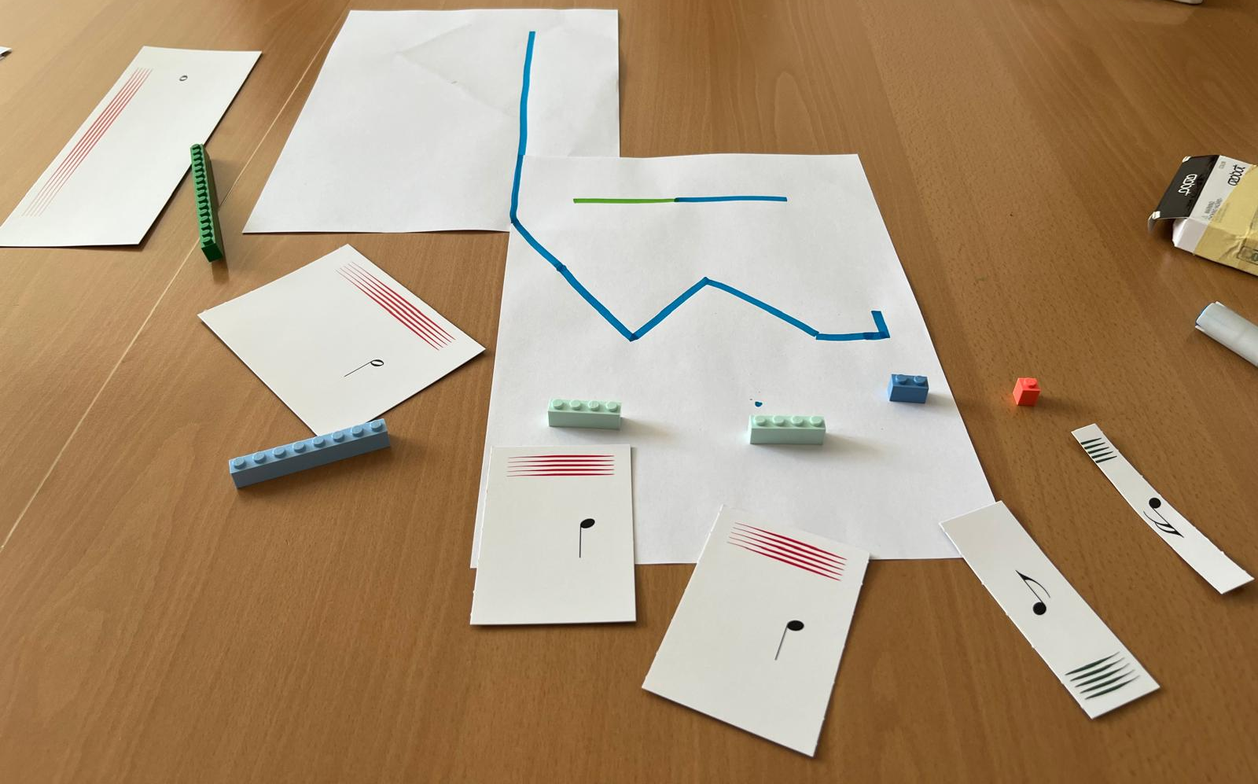
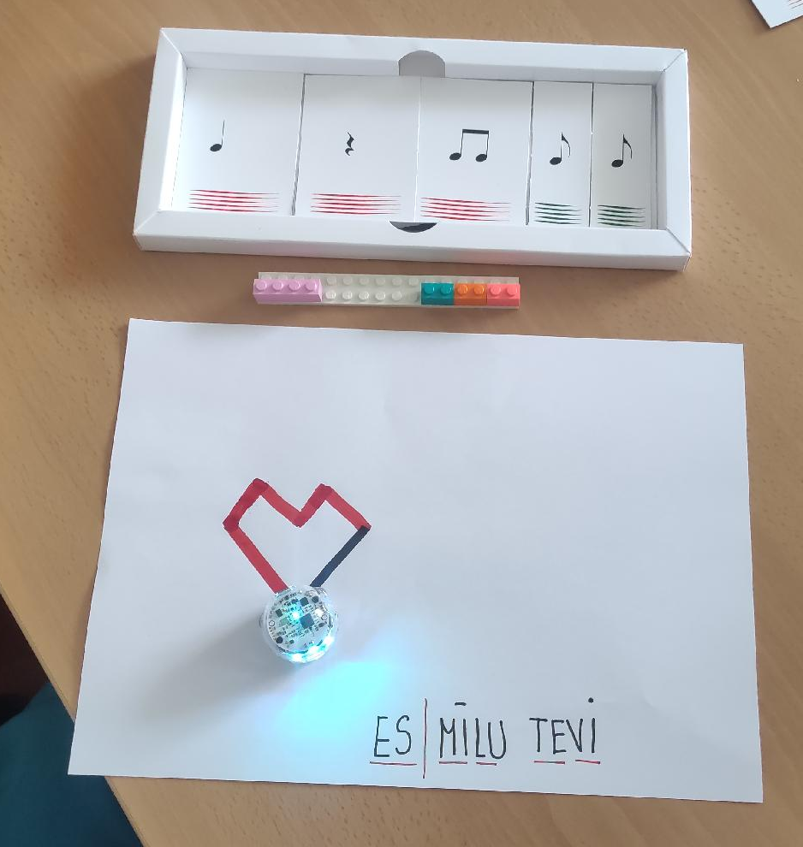
THANK YOU!
Maddalena Cocco
maddalena.cocco@unimib.it

